Slide 1

GEO Functional Toolkit
Practical Handbook
Jakub Falkowski – Global GEO Lead
CXCT – Intelligent Digital Experience
v.1.0 last updated 21st August 2026
©2026 Schneider Electric. All Rights Reserved.

Slide 2
About this document
Introduction to GEO Functional Toolkit
As AI-powered search and generative engines reshape how people discover information, traditional SEO tactics alone are no longer enough to ensure visibility. This GEO Functional Toolkit is a comprehensive set of knowledge, best practices and frameworks designed to help content owners optimize their digital presence for generative AI platforms.
This Toolkit is divided by content type optimization and GEO activity for easier use of this complex document. Each element is located in its own chapter containing:
GEO context for the topic
Optimization strategies/actions to take
Checklist
Toolkit creator: Jakub Falkowski
Thank you to all content cotributors: Shuchi Mahajan, Mateusz Madejowski, Bartosz Żak, Michel Page, Christopher Clerc, Tremain Jennings
Special thanks to reviewers: Agnieszka Dabal, Alexis Bouilliez, Alina Tucan, Anakshi Das, Anthony Locke, Antoine Bish, Archana Kumari, Arun Kumar Ramaswamy, Basak Nayci, Catherine Alardo, Georgios Dampanis, Giuseppe Forciniti, Ilyana Anufrieva, Jayaprakash Kutty Shankar, Karina Da Silva, Kieren Palmer, Maciej Malesa, Matt Graves, Matthew Wood, Neha Panchal, Paul Flores, Piotr Walczuk, Prankul Gupta, Raghavendra Singh, Ramon Rubio, Sanjay Mehta, Salman Kureishi, Sergiy Borovik, Shalini Balodi, Shaura Avasti, Snezana Dragin, Stuart Linacre, Suraj Bakane, Umer Noor, Yusuf Hakimuddin

Slide 3
Table of contents
List of the chapters
Chapter 1: Introduction to GEO
Chapter 2: Prompt Research
Chapter 3: Universal GEO Content Writing Rules
Chapter 4: GEO Optimized Images
Chapter 5: GEO Optimized Videos
Chapter 6: GEO Optimized FAQ
Chapter 7: GEO Optimized Documents
Chapter 8: GEO Optimization on Blogs
Chapter 9: Prompt into Content – Reverse Engineering
Chapter 10: GEO Optimization and Social Media/Onlines Communities
Chapter 11: Linking Structure to Enhance GEO – Internal and External
Chapter 12: Editorial and Product UX design
Chapter 13: GEO Analytics
Chapter 14: Technical GEO
Glossary and Main Contacts

Slide 4
Chapter 1: Introduction to GEO
Jakub Falkowski
©2026 Schneider Electric. All Rights Reserved.

Slide 5
GEO — Generative Engine Optimization
A new discipline for earning visibility inside AI-generated answers.
What Is GEO?
Why It Matters?
Generative Engine Optimization (GEO) is the practice of structuring, writing, and distributing content so that generative AI systems — ChatGPT, Perplexity, Gemini, Copilot, and Google AI Overviews — can understand, trust, and directly reference your brand when they generate answers to a user's question.
Where SEO earns a ranked position on a results page, GEO earns a mention or citation inside the answer itself. It sits alongside SEO as a parallel discipline, focused on becoming a source that AI models choose to draw from and quote.
Answers Are Replacing Links
Many questions are now resolved directly inside an AI chat, with no visit to any website at all.
Traditional SEO Doesn't Transfer
Ranking well in classic search results doesn't guarantee being surfaced or cited by an AI model's answer.
Visibility Is Becoming Curated
AI systems draw on a small number of sources per answer, making inclusion a competitive, winner-take-few game.
Early Movers Shape the Narrative
Brands optimized for AI citation now influence how their category and products get described going forward.
Property of Schneider Electric |
Page 5

Slide 6
How is GEO Different from SEO?
GEO is not SEO with a new name – short comparison.
Dimensions | SEO | GEO
Goal | Rank in a list of links | Be mentioned and cited in the answer an AI synthesizes.
Success metric | Position, clicks | Citation share, brand mentions
What matters | Keywords, backlinks, on-page UX | Fact density, structure, third-party validation
Content shape | Long intros, keyword density | Answer-first, self-contained, quotable statements
Property of Schneider Electric |
Page 6

Slide 7
GEO Lifecycle
Ongoing effort to answer the needs of the users.
1. Analytics
We analyze where we are in the GEO journey and what we should improve to answer the user needs for information.
GEO
Analytics
Prompt research
Content optimization
UX/UI check
Page update
Page deployment
6. Page deployment
We ensure the page is live in all relevant markets.
2. Prompt research
We check the prompts to understand what users are asking AI.
5. Page update
We update the page with new content and/or layout.
3. Content optimization
We create tailor-made content based on prompt research.
4. UX/UI check
We ensure that the page provides good user experience and have high quality assets visible to AI.
Important:
GEO, exacly like SEO, is ongoing organic effort.
It’s an endless cycle of data-driven improvements to to improve our exposure and follow latest trends..

Slide 8
GEO Strategy Implementation Step by Step
Where to start and next steps.
If our enhancements works, our brand will be mentioned and our page will be cited (not always the two are connected. We can be mentioned but not always cited. But beeing mentioned is a win.). We should keep observing the results to ensure that we remain mentioned and cited.
First, we need to define the prompts we want to optimize for by doing the prompt research.
Next, we optimize the content fixing content gaps by optimizing it to answer the selected
prompts.
Once the content is optimized and published on the page, we monitor the AI models results for the selected prompts.
If our enhancements didn’t work, we should continue working on content optimization, trying to understand what the winning content has, that we do not.

Slide 9
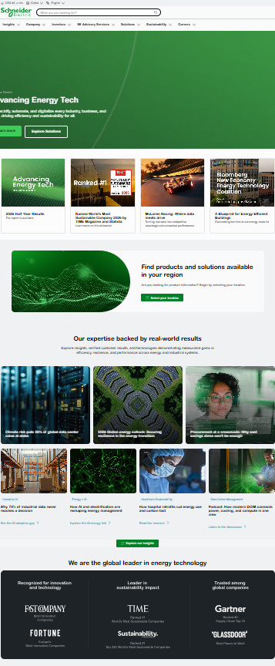
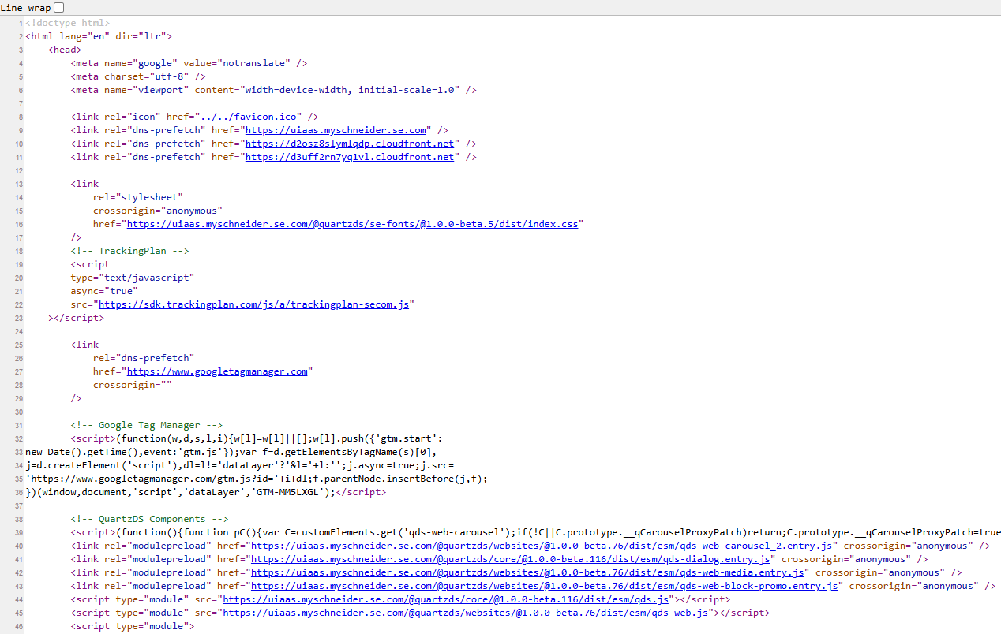
Anathomy of GEO Ready Page
Technical GEO in place. Not visible to human, very much visible to the machine.
How the optimized page look like.
Front-loaded, quotable answers - most important message is placed in top 2-3 components on the page.
Conversational human tone - matching search intent and the conversational, context-rich language that performs best
Content and assets optimized for the selected prompts
Entity and credibility signals - expertise markers, and internal cross-links reinforce authority and trust, which enhances the credibility recognized by AI platforms.
Scannable bullet summaries – content easy to understand and use by AI.
Authoritative citations and sourcing - linking out to credible external sources and citing data to determine trust.
Important: Page on screenshot is our se.com home page – used only to ilustrate the example, not actaully optimized page.

Slide 10
Chapter 2: Prompt Research
Jakub Falkowski
©2026 Schneider Electric. All Rights Reserved.

Slide 11
Everything Starts with the Prompt
Keywords now becoming topics for prompt research
What is prompt research?
Prompt research is the GEO-era counterpart to keyword research. Instead of estimating search volume for keywords, we identify the recurring, natural-language questions and follow-up prompts real buyers put to AI assistants - existing or new pages, creating content that matches each prompt our brand needs to own.
Prompts instead of keywords – new opportunities
Prompt era gives companies like Schneider Electric new opportunities to now claim leadership where it was impossible with keywords. During prompt research, it is very important to identify the prompts we can win, even if the topic is broad. For example keyword “water industrial solutions” was beyond our reach, but now, targeting the right prompt, we can claim a piece of this topic.
Keyword (topic) -> Prompt
“best UPS data center”
“What's the most reliable UPS setup for a mid-size data center in a humid climate?”
“EcoStruxure vs Desigo”
“How does EcoStruxure compare to Siemens Desigo for a multi-site retail portfolio?”
“industrial automation ROI”
“What payback period should I expect from automating a mid-size manufacturing line?”

Slide 12
Enhanced Prompt Research: AI Architecture
Move from what the AI knows to what the AI cites.
How Large Language Models (LLMs) answer — two layers
Parametric Memory – what AI knows The model's internal, pre-trained knowledge. Static, generic, and prone to hallucination.
Optimization strategy: grounded signals
Action: Move beyond keyword volume to the real technical friction points and questions practitioners actually ask. Sources: High-authority technical communities where real-world problems get solved:
Retrieval Layer (RAG) – what AI cites
The model actively searches the web and databases for real-time, grounded, citable facts.
The shift: optimize for the Retrieval Layer — we don't just want AI to know us, we want it to cite our specific grounded content.
r/*electrical
r/*HVAC
r/*PLC
r/*manufacturing
r/*sysadmin
ServeTheHome
Important: Optimizing for the retrieval layer makes Schneider the cited authority for complex technical queries — not just a recognized brand name.
*r/ means Redit

Slide 13
Sources of the Prompts
Places where we can harvest the prompts
Public Web
This is very good source of prompts: communities, People Also Ask feature, social media, and FAQs are solid source that provides real live querries users have.
Support Teams (not covered in this toolkit)
Excelent source of prompts: support teams and FAQ teams can support providing real-life questions from our customers.
AI Agents
AI agents can be helpful to provide us the information about the topics users are talking about. We can train AI agents to provide us specific set of prompts.
Available Paid Tools (not covered in this toolkit)
There are multiple tools available in the market to harvest prompts. They use different methodologhy to do the prompt research.
Important: there are multiple tools in the market that can support in the harvesting the prompts. They use different methodologhy and interface hence we will focus in this toolkit on harvesting the prompts without access to the dedicated tools – using only web and public AI agents.
Property of Schneider Electric |
Page 13

Slide 14
Prompt research in web
Searching trough communities, social media, and FAQs - way to hear buyers ask questions in their own words.
Communities and forums
Search Reddit/industry forums for your category and “vs”, “worth it”, “how to”
Sort by top/recent in relevant subreddits & LinkedIn groups
Log the exact question wording, not just the topic
Social media and video
Scan comments on competitor and industry YouTube/LinkedIn posts
Use social-listening tools to track category hashtags and mentions
Note recurring objections and follow-up questions in threads
FAQs and Q&A sites
Collect FAQ sections from your site, competitors', and review sites
Pull Google “People Also Ask” boxes for core category terms
Check Quora/trade-association Q&A pages for buyer phrasing
Advantage
Authentic, unfiltered buyer language Surfaces emerging questions early High volume of raw material No proprietary data access needed
Risk
Noisy and unstructured — needs manual filtering Skews to a most vocal, not always fully representative, audience Potential manual effort to keep current (can be solved using the specific tools)

Slide 15
Prompt research with AI Model Support
AI engine can support by quickly analyzing the web for the topics that people are talking about
LLM prompt extrapolation
Feed an LLM your audience, offer, and funnel stage as context
Always do the prompt extrapolation on multiple AI agents (ChatGPT, Perplexity, Gemini, Copilot and Claude) – this is how you will avoid AI hallucinations and if prompts overlaps among the AI engines, it is very likely those are the hot topics
Ask it to generate realistic prompts and natural follow-up questions
Repeat per product line and buyer persona to widen coverage
More information you will feed LLM – more accurate will be the prompts generated by it
Direct AI engine testing
Run seed prompts through multiple AI agents (ChatGPT, Perplexity, Gemini, Copilot and Claude)
Use incognito mode (not logged-in experience) and close and re-open the search for each query (avoid history of searching influence your research)
Capture the follow-up questions each engine itself suggests
Use a clean/logged-out session to avoid personalization bias
Advantage
Scales to hundreds of prompts in minutes Surfaces long-tail phrasing humans miss Auto-scores by difficulty and opportunity Tests real AI-engine behavior directly, not a proxy for it
Risk
LLM-generated prompts can feel synthetic vs. real buyer phrasing Quality depends on the underlying model and the right information provided to LLM Outputs still need human validation
Important: when feeding LLMs with information for the prompt research, remember NOT TO insert any confidential and/or sensitive data to the AI model. Always follow cybersecurity training and principles.

Slide 16
The Grounding & Topical Mapping Methodology
A systematic approach to building AI-citation-ready content.
1
2
3
4
PAA (People Also Ask) & Intent Extraction
Community Signal Grounding
Topical Map Construction
Prompt Sequencing & Chains
Scrape Google 'People Also Ask' and related queries to capture the exact phrasing of user intent.
Cross-reference PAA with Reddit and technical forums to extract the 'ground truth' — the real friction points and consensus.
Group grounded intents into a structured topical map: core category - subtopics - specific prompts.
Identify the Pivot Prompt, the Lead-up context before it, and the Follow-on we guide the user to next.
Goal: understand how the persona asks the question.
Goal: validate intent and find the technical detail an authoritative answer needs.
Goal: signal comprehensive, deep expertise to the LLM.
Goal: control the conversational narrative around Schneider's value.

Slide 17
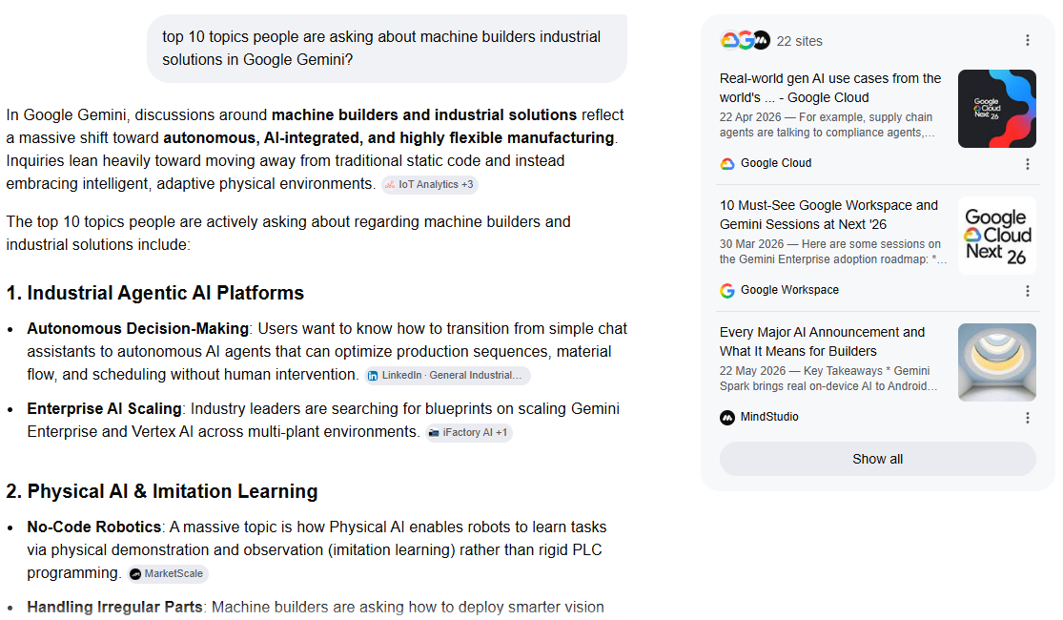
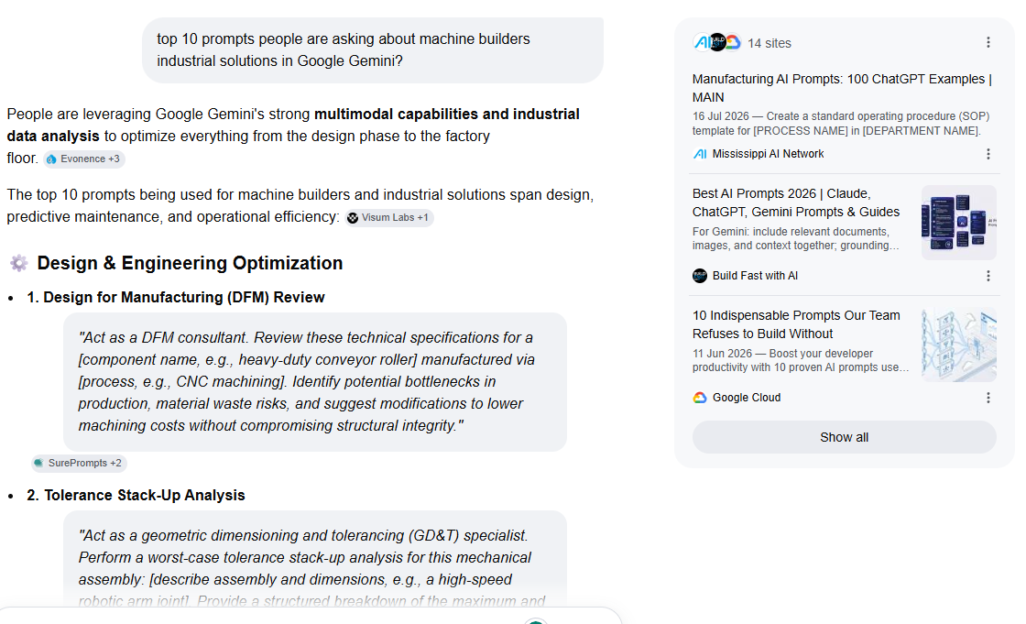
Prompt Research with AI Model – Simulation
Always do the prompt extrapolation on multiple AI agents.
AI models suggested for the research: ChatGPT, Perplexity, Gemini, Copilot and Claude
Simulation context: Sarah is a maketer in one of the divisions. She wants to discover what people are talking about in relation to machine builder industrial solutions to ensure that Schneider Electric content is mentioned and cited. She doesn’t have any knowledge on the topic, so she needs to start her research from the beginning.
Topic oriented prompt: top 10 topics people are asking about machine builders industrial solutions in Google Gemini?
Prompt oriented prompt: top 10 prompts people are asking about machine builders industrial solutions in Google Gemini?

Slide 18





Prompt Research with AI Model - Simulation
Always do the prompt extrapolation on multiple AI agents.
AI models suggested for the research: ChatGPT, Perplexity, Gemini, Copilot and Claude.
Simulation context: Sarah now understands the type of topics/prompts, as provided by Google Gemini. The same excercise with exact same prompts should be repeated in other AI engines to find the matching topics/prompts. Once the matching item is selected. Sarah can keep narrowing it down providing as much information to the AI as she considers relevant, to build the prompt that would match her business and provide the impact.
Picked topic: Humanoid Robots & Next-Gen Cobots
Optional next prompt including persona: As a machine builder what do you want to know about...
Optional next prompt including funnel: What would you like to know if you are considerating...
Optional next prompt including intent: What is the most important aspect, if you you want to compare...
Narrowing down the research including very specific prompt: As a machine builder considering [...], what do you want to know and what do you want to compare...
Important: always use multiple AI models for prompt research and always ask the same questions to all LLMs. You can try inserting the same prompt in the same LLM multiple times or few days in a row to see if the answers will be matching.

Slide 19
Strategic Scoring & Prioritization
From subjective difficulty to a quantitative impact model – calculating the impact.
Beyond simple difficulty
The gap: Relying on a 'difficulty' score alone is insufficient for high-stakes B2B GEO.
The need: a quantitative framework that prioritizes opportunities by their impact on market share and AI-search authority.
Score dimensions
Competitive Density (0-25) How saturated is the AI response landscape — giants or a void? | Citation Share Potential (0-25) How likely is Schneider to become the primary cited source?
Business Impact (0-25) How closely does it align with revenue drivers and strategic lines? | Technical Feasibility (0-25) Do we have the experience, expertise, authoritativeness and trustworthiness (E-E-A-T*) to create content and assets?
Important: A quantitative score allocates resources to the GEO opportunities that deliver the highest strategic value and ROI.
0-100
GEO Strategic Score
GEO tips & tricks
You don’t need to evaluate the score by yourself – use AI to do it for you, using the questions from the table.
*E-E-A-T . It is a framework found in Google's Search Quality Rater Guidelines to evaluate the credibility, quality, and helpfulness of web content.

Slide 20
Cluster the Prompts by Intent and Funnel Stage
Cluster the prompts first, then map the owned content to identify the gaps in content.
Search Intent – (the Core Four)
Informational
Commercial
Transactional
Navigational
Here is a prompt analysis matrix example for use after the prompt research. The matrix can help to understand:
What is the intent of the prompt
What is the funnel stage
Do we have the asset in place already
What would be the possible action
What can we win
This assessment helps to narrow down the list of prompts to pick only the ones that are relevant for the current business needs or gives us an idea on where we should start.
Funnel Stages (Modern Buyer's Journey)
Awarness
Consideration
Decision
Purchase
Post-purchase
Intent | Example prompt | Funnel stage | Mapped asset | Action | Opportunity
Informational | “What are food and beverage industrial solutions about?” | Awareness | Owned - platform overview page | Optimize the content for GEO | Low – broad topic
Commercial | “Compare EcoStruxure vs Desigo for retail portfolios” | Consideration | Gap – no head-to-head asset exists | Build the asset | High – competitors comparison
Transactional | “Where can I buy the best UPS?” | Decision | Owned - marketplace | Optimize Product page | High – monetization
Navigational | “How can I access my MySchneider account for trainings?” | Post-purchase | Gap – MySchneider navigation asset | Build MySchneider navigation document | High – customer satisfication

Slide 21
The challenge isn't getting cited - it's getting cited on the topics people are actually talking about.

Slide 22
Chapter 3: Universal GEO Content Writing Rules
Shuchi Mahajan, Mateusz Madejowski, Bartosz Żak, Jakub Falkowski
©2026 Schneider Electric. All Rights Reserved.

Slide 23
How do we write content differently for GEO?
Core mindset shift: You are no longer writing only to rank or persuade.​
In GEO, every page must deliver clear, extractable answers for AI‑led discovery.
Traditional page mindset (Before GEO)
Narrative‑first Marketing‑heavy Implicit value Visual-dependent Broad, generic
The GEO page mindset (GEO-ready)
Answer first Fully answer the question — not just earn the click. Be extractable Neutral tone of voice, clean headings, structured text, bullet points, and factual density. Outcome led clarity AI recommends only complete, reliable, and trustworthy information. Clear context & segmentation Be explicit to establish relevance. Invert the pyramid Put the core message at the very top of the page.
Important: Write for AI‑retrievable layer.
If an AI agent can’t extract a clean, factual answer explaining what the page offers and why it matters, it will surface a competitor instead.

Slide 24
GEO Principle: Direct Answer First vs Narrative‑First
Answer the user’s question immediately.
Do not make users — or AI — read past positioning, vision statements, or marketing copy to find the core answer.
Before: Narrative‑first (SEO/marketing‑led)
Transform the way you manage energy with our innovative solutions. As buildings become more complex, organizations need smarter, future‑ready technologies to stay competitive. Our portfolio of advanced platforms helps enterprises drive efficiency, resilience, and sustainability across operations.
After: Direct answer first (GEO‑ready)
What is an energy management system? An energy management system monitors, analyzes, and optimizes energy consumption across buildings or facilities using metering, automation, and analytics to reduce costs and improve efficiency.
Why this is not optimized GEO?
No clear definition of the solution
Core answer is delayed or missing
AI cannot extract a concise, factual response
Why this works for GEO?
The answer is immediate and self‑contained
Clear definition, audience, and outcome
AI can confidently extract and reuse the answer
Important: If the answer is not in the first few lines under each heading., AI will not wait to find it. Put the definition and value up front — explanation can follow.

Slide 25
GEO Principle: Fact‑based, extractable vs narrative prose
Write in facts, which AI can extract — not prose it has to interpret.
AI systems favor structured information (lists, tables, clear statements) over long narrative prose.
Before: Narrative prose (hard to extract)
Our energy optimization solutions are designed to help organizations improve performance and sustainability. By leveraging advanced technologies and deep domain expertise, businesses can gain better visibility into consumption patterns, identify inefficiencies, and support long‑term operational goals.
After: Fact‑based, extractable content (GEO‑ready)
What does the solution do? Monitors and optimizes energy consumption across sites What outcome does it deliver? Lower energy costs and improved efficiency
Why this is not optimized for GEO?
“designed to help” describes intent, not function
“leveraging advanced technologies and deep domain expertise” is classic marketing abstraction
“businesses can gain better visibility…” outcomes are implied, not owned by the solution
No atomic fact on what does the solution do.
Why this works for GEO?
Capabilities are explicit​
Information is structured into extractable units​
Outcomes are owned by the solution​
AI can confidently summarize and reuse the content
Important: If information cannot be broken into facts, AI cannot reuse it.
Use lists, tables, and clear statements so answers can be extracted without interpretation.

Slide 26
GEO Principle: Outcome‑led Clarity
State outcomes explicitly — do not assume the value is obvious.
AI systems need concrete results they can summarize and recommend, not vague benefit statements.
Before: Generic value statements (hard to reuse)
Our solutions help organizations improve efficiency, sustainability, and performance across operations.
After: Outcome‑led, specific results (GEO‑ready)
What outcomes does this deliver? Reduces energy costs across commercial sites Improves operational efficiency through usage optimization
Why this is not optimized for GEO?
Benefits are broad and interchangeable
No measurable or specific outcome
AI cannot determine why or when to recommend this content
Why this works for GEO?
Outcomes are explicit and concrete
Value is clear without additional context
AI can confidently match outcomes to user intent
Important: If outcomes are not clear, AI cannot judge relevance.
State specific results so AI knows when to surface your content.

Slide 27
GEO Principle: Clear Context and Segmentation
Be explicit about who the content is for and when it applies.
AI systems need clear context (role, scenario, or use case) to determine relevance.
Before: Broad, unsegmented content
Our energy management solutions are designed to support organizations across industries by improving efficiency, resilience, and sustainability.
After: Context‑specific, segmented content
Who is this for? Facility and energy managers in commercial buildings. When is it used? When reducing real‑time energy consumption and operating costs across multiple sites.
Why this is not optimized for GEO?
Audience is undefined
No usage scenario or trigger
AI cannot confidently match to a query
Why this works for GEO?
Audience and scenario are explicit
Context aligns with intent
AI can determine relevance
Important: If context is not clear, AI cannot match your content to the right query.
State the specific audience and scenario so AI knows when and for whom to surface your content.

Slide 28
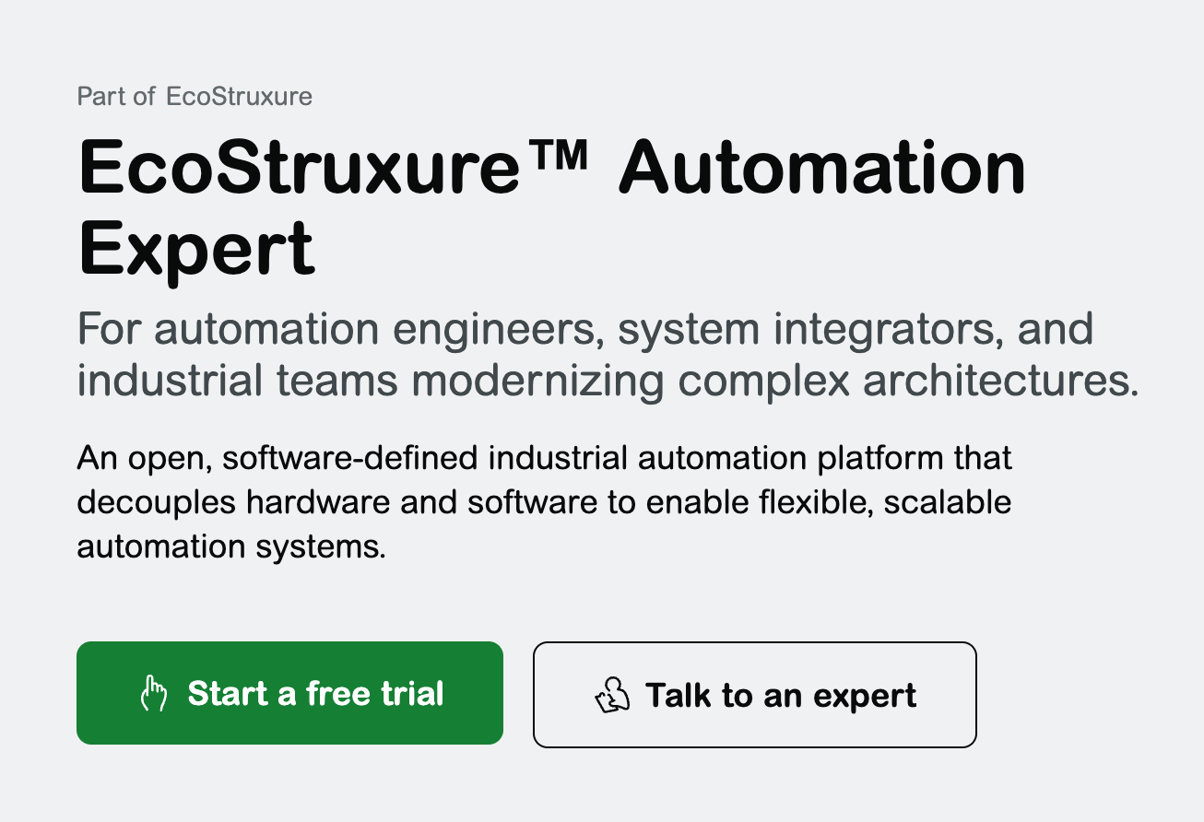
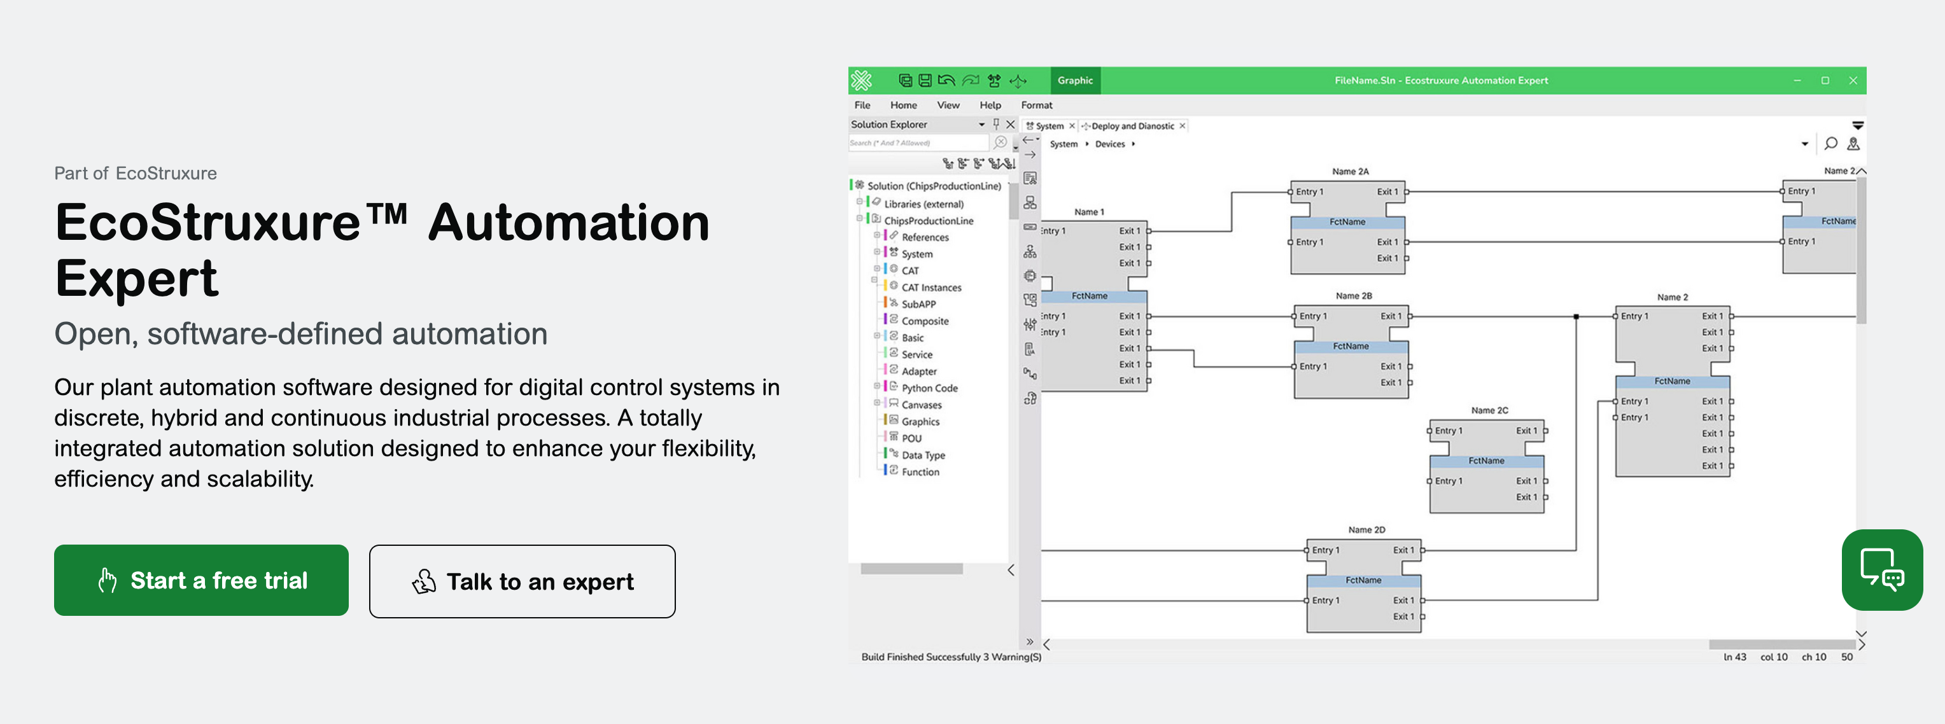
GEO in action: Banner Rewrite Example
Before
Open, software‑defined automation Open, software‑defined automation improves flexibility, reduces engineering effort, and enables continuous optimization of industrial systems.
After
What is EcoStruxure™ Automation Expert? An open, software‑defined industrial automation platform that decouples hardware and software to enable flexible, scalable automation systems. Who is it for? Automation engineers, system integrators, and industrial teams modernizing complex architectures. When should it be used? When flexible, software‑centric control is required in complex industrial architectures. What outcomes does it deliver? Reduced engineering effort Faster system adaptation Greater flexibility and scalability
Why this is not optimized GEO?
No explicit definition
Audience not stated
Usage scenario unclear
GEO tips & tricks
Perform quick GEO test: if AI reads only the banner section, can it confidently explain all four?
Yes → GEO‑ready
No → not GEO - optimized
Why this works for GEO?
Answer first
Clear context
Extractable outcomes
Important: This fix restructures the top of the page — it does not rewrite everything.

Slide 29


GEO in action: CTA (Call to Action) – Optimization Guide
General Rules
AI engines prioritize natural, highly-specific CTAs that directly match a reader's intent to encourage user action CTAs should optimize for user intent and clarity, not marketing language Best CTA Practices Place CTAs after informational sections Use intent‑based language Avoid vague phrases like “Learn more”, “Know more”
Weak CTA examples (to avoid) | Good CTA examples (GEO compliant)
[Download now] | [Download the energy management guide]
[Learn more] | [Access the cybersecurity white paper]
[Get started] | [Get the buildings energy report]
[Unlock insights] | [Read the guide to IT/OT convergence]
Why they are not GEO friendly?
No content meaning
Not searchable or descriptive
Relies on marketing language.
Why they work?
Describes what the user gets
Neutral, informative, AI‑readable
Matches the asset title and summary
Important: This fix restructures the top of the page — it does not rewrite everything.

Slide 30
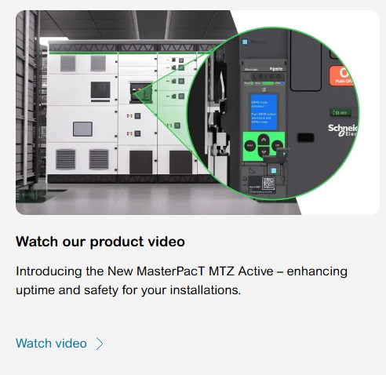
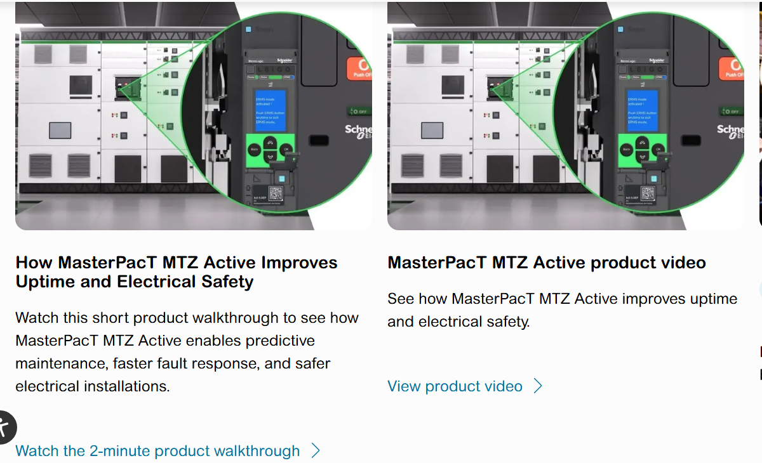
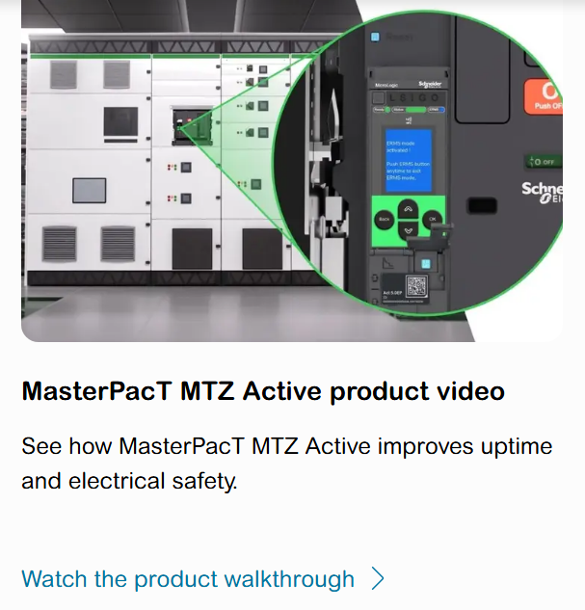
GEO in action: Short Content Forms for Object Description -Examples
Example from live page without GEO-optimization
Improved copy (no character constraints)
Improved copy (with character constraints)
What needs fixing (GEO gaps)
Headline is too generic
No outcome-driven framing
Weak CTA for AI summarization
What works for GEO
Answer‑first framing
Strong entity + outcome linkage
AI‑quotable structure
CTA reinforces intent, not just action
What works for GEO
“See how” framing
Short entity recognition and outcome keywords
Strong CTA signaling learning + explanation

Slide 31
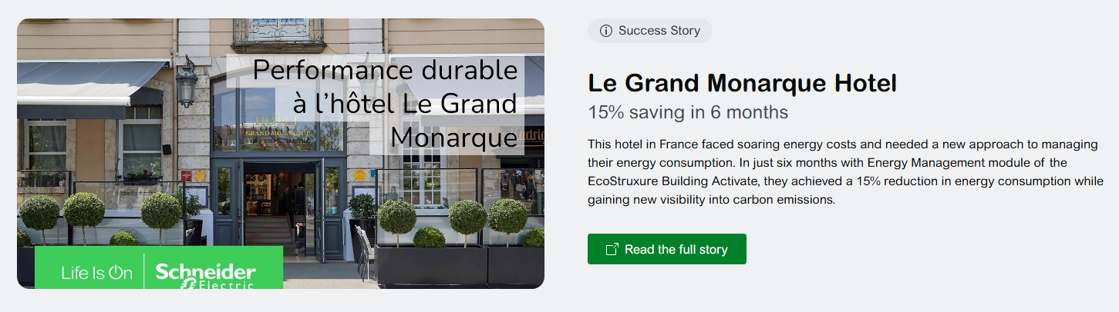
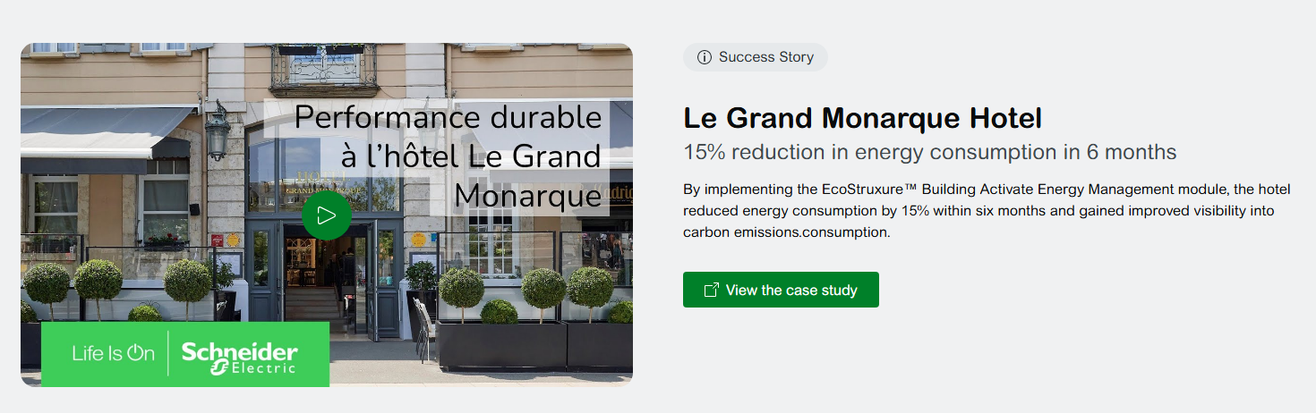
GEO in action: Medium Content Forms for Object Description
Example without GEO-optimization
Title: Le Grand Monarque Hotel Subtitle: 15% saving in 6 months Description: This hotel in France faced soaring energy costs and needed a new approach to managing their energy consumption. In just six months with Energy Management module of the EcoStruxure Building Activate, they achieved a 15% reduction in energy consumption while gaining new visibility into carbon emissions. CTA: Read the full story
Improved copy after GEO optimization
Title: Le Grand Monarque Hotel Subtitle: 15% energy cost savings in 6 months Description: By implementing the EcoStruxure™ Building Activate Energy Management module, the hotel reduced energy costs by 15% in six months and gained improved visibility into carbon emissions. CTA: Read the Le Grand Monarque Hotel case study
What works for GEO
One clear primary outcome
Clear value story at-a-glance
Strong outcome - solution - timeframe link
CTA supports intent and performance
What needs fixing (GEO gaps)
Multiple success messages (cost, consumption, carbon)
Headline and body not fully aligned
Outcome - solution link is weak
Generic CTA reduces reuse effectiveness

Slide 32
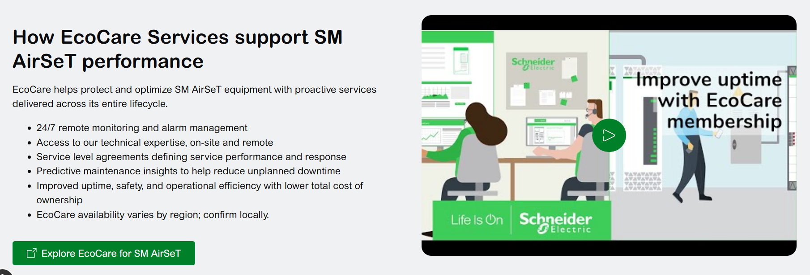

GEO in action: Long Content Forms for Object Description
Example without GEO-optimization
Title: Combine your SM AirSeT with EcoCare Subtitle: Protect your equipment with advanced services Description: With EcoCare membership services, a next‑generation service plan, you gain exclusive support for your equipment from day one and throughout its entire lifecycle. For minimal investment compared with your overall CapEx, you'll enjoy 24/7 remote monitoring and alarm management, and access to technical expertise, on‑site and remotely, as defined by the service level agreement (SLA). This proactive approach helps reduce the risk of unexpected downtime and related costs whilst enhancing the uptime, safety, and efficiency of your operations. Please verify the availability of EcoCare in your region through a local services sales representative. If EcoCare is not yet available, leverage the EcoStruxure Service Plan. CTA: Learn more about EcoCare Plan
Improved copy after GEO optimization
Title: How EcoCare services support SM AirSeT performance Description: EcoCare helps protect and optimize SM AirSeT equipment with proactive services delivered across its entire lifecycle. 24/7 remote monitoring and alarm management Access to Schneider Electric technical expertise, on‑site and remote Service level agreements defining service performance and response Predictive maintenance insights to help reduce unplanned downtime Improved uptime, safety, and operational efficiency with lower total cost of ownership EcoCare availability varies by region; confirm locally. CTA: Explore EcoCare for SM AirSeT
What works for GEO
Value is clear and visible at first glance
Scannable structure suited for carousel UX
Product and service entities are clearly connected
Easily understood and summarized by AI systems
What needs fixing (GEO gaps)
Dense paragraph (low scanability)
Value buried deep in text
Harder for AI to summarize key outcomes

Slide 33
GEO in action: Videos/images description content
Context
AI engines do not "watch" video or „see” the image in the same way humans do. Instead, they "read" and process the text and descriptive data associated with videos to include them in generated answers. GEO rules for video/image content: Never rely on video/image alone Always add: Video/image title 3–4 bullet takeaway summary Use descriptive content, not campaign names
Example of what AI will see
Video/image title: How EcoStruxure™ Power Monitoring improves energy visibility Description (what the AI/user sees): EcoStruxure Power Monitoring gives facility teams visibility into consumption, performance issues, and efficiency opportunities. Real-time, granular data collection Centralized dashboards and analytics Actionable alerts and reporting CTA: Watch the energy monitoring walkthrough
GEO Tips & Tricks
Checklist for video/image:
Video/image is supported by text
Clear, descriptive title
AI‑readable summary content
Important: AI does not “see” visual assets, description is what matters. To know more about videos/images please visit video/image related chapters of this playbook

Slide 34


GEO in action: Gated Content Item Description
Context
AI engines cannot access gated content. Principle: Gate the deep dive, not the knowledge Recommendation: Create ungated summary blocks: Key findings Definitions Frameworks They must be: Visible Indexable Descriptive
Example
Page: Schneider Electric Cybersecurity White Paper (se.com -> Download -> Document) What the AI/user sees BEFORE the gate: Title (visible and descriptive): Cybersecurity at Schneider Electric – Addressing IT/OT Convergence Short description (visible text): This white paper explains cybersecurity risks from IT/OT convergence and best practices for securing industrial environments. CTA: Download the white paper
Benefits:
Clear explanation of value before registration
Search engines can index the description text
Content is not hidden without context
Important: AI cannot see gated content—make the knowledge visible first, and gate only the detailed depth.

Slide 35
GEO Dos and Don’ts
Short list of content principles to keep in mind any time you create content
Do
Write for AI answers Write for answers, not campaigns Make context explicit Structure for extraction (lists, tables, short sections) Write for reuse, not persuasion Update content every 6–12 months for content freshness Think: “Would an AI confidently quote this sentence?”
Don’ts
Create AI friction Bury meaning in storytelling Assume AI “figures it out” Hide core information in PDFs or gated assets Rename sections creatively at the cost of clarity Rely on vague value claims
GEO Gate
Before publishing content, be sure that you have: Clear page definition on the top Audience and scenario explicitly stated Outcomes clearly listed Content is fact‑based and extractable No critical info locked behind forms

Slide 36
GEO Writing Checklist - Onepager
One‑page GEO writing checklist for content creation.
Answer first
Does the page answer the primary question in the first few lines? Is the definition or explanation immediate and self‑contained? Can the answer be lifted out without additional context?
Write extractable content
Are key points written as facts, not narrative prose? Are lists, tables, or short statements used where possible? Can each statement be independently extracted and reused by AI?
Outcome‑led clarity
Are outcomes stated explicitly (not implied)? Are benefits specific enough to judge relevance? Would AI know why and when to recommend this content?
Clear context and segmentation
Is the audience clearly defined (role, persona, user)? Is the scenario or trigger explicitly stated? Would an AI know which query or situation this content applies to?
Trust and clarity signals
Is the content current and well maintained? Are claims verifiable, concrete, and non‑exaggerated? Is the language clear, neutral, and informational (not marketing‑heavy)?
Final GEO check
If an AI had to summarize this page in 3–4 sentences, would it clearly understand: What it is Who it is for When it applies What outcome it delivers If not, the content is not yet GEO‑ready.

Slide 37
Today we should write to be quoted, not just read.

Slide 38
Chapter 4: GEO Optimized Images
Jakub Falkowski
©2026 Schneider Electric. All Rights Reserved.

Slide 39
Why images need a specific chapter in this playbook?
Context
AI assistants mostly don't “see” your images the way a human does. In typical browsing and citation flows, they read the text around the image — and decide whether to reference the page based on that. Additional note: vision models exist (GPT-4V, Claude Vision) — but textual context still dominates relevance scoring in practice.
What AI Assistant can actually read?
HTML alt attribute (Alt tag)
Surrounding paragraph text
Filenames
Structured data (schema - technical GEO)*
Important: GEO for images is really “textual context engineering” for visual assets.
*For schema markup explenation please visit Chapter 14 of this Toolkit.

Slide 40

Alt Text: highest-leverage signal
Every AI assistant that processes page HTML code will „see” on the image what you tell it to see.
Incorrect alt text example
alt="construction workers engineers hard hats safety vests meeting team builders contractors site” Reads as a keyword dump, not a description. Unnatural phrasing, hostile to screen readers, and gets discounted by AI/search systems the same way Google discounts stuffing
Context and rules
Every informative image gets alt text — no exceptions, no empty strings: Aim for 80–140 characters: descriptive but concise Describe purpose in context, not just contents Work keywords in naturally — never stuff Keep alt text consistent and unique across product variants
Correct alt text example
alt="Seven construction engineers in hard hats and safety vests reviewing blueprints together at a table” Specific, natural, and describes the actual content and purpose of the image — who's there, what they're wearing, and what they're doing.
GEO tips & tricks
If your target keyword fits naturally, include it. If it forces the sentence, leave it out.

Slide 41
Surrounding Text and Placement
The content around an image is almost as important as the alt attribute.
Context
GEO rules for image description content: Never rely on video/image alone Always add: Video title 3–4 bullet takeaway summary Use descriptive content, not campaign names
Example of what AI will see
Image title: How EcoStruxure™ Power Monitoring improves energy visibility Description (what the AI/user sees): EcoStruxure Power Monitoring gives facility teams visibility into consumption, performance issues, and efficiency opportunities. Real-time, granular data collection Centralized dashboards and analytics Actionable alerts and reporting CTA: Watch the energy monitoring walkthrough
Content around image - layout
Image title: Explanatory paragraph sits right next to/at the bottom of the image it illustrates. Description (what the AI/user sees): Caption underneath gives a second independent text signal. CTA: clear indication on what the action is about

Slide 42
Filenames
Secondary item but easy win.
Filename with zero context
IMG_007.jpg Tells search engines and AI assistants nothing
Important: the filename's subject shouldn't contradict what the alt text says.
Filename with context
engineer-in-power-plant.jpg Descriptive, hyphenated, includes product/model naturally

Slide 43
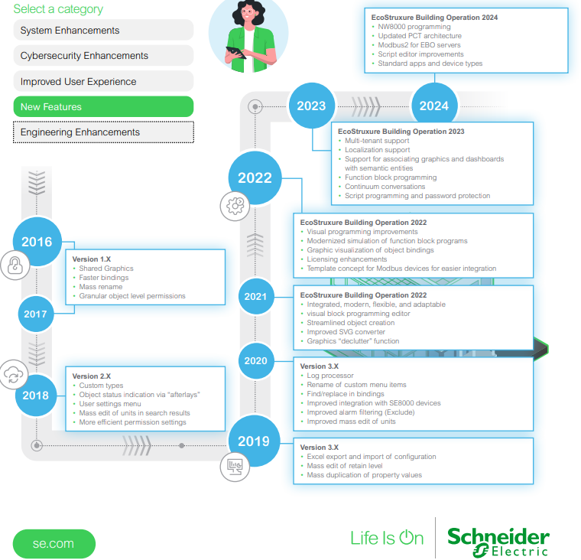
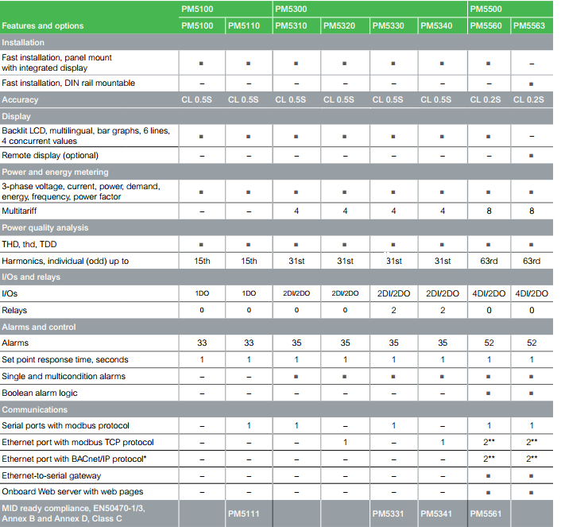
Multimodal Content
Pages that explain concepts in more than one modality get more recognition among AI engines.
Diagrams, infographics (example below), charts - each with its own descriptive alt text - not a shared generic tag.
Comparison tables - for anything evaluative: specs, pricing tiers, before/after.

Slide 44
Common Mistakes to Avoid
Image’s donts.
Empty alt on informative images
AI assistants simply skip them — you lose the signal entirely
Generic, duplicated alt text across variants
e.g. every color of a product using the same tag
Keyword-stuffed alt text
Detected and discounted the same way Google discounts it; hostile to screen reader users
Lazy-loading the hero image
A Core Web Vitals killer that indirectly hurts crawlability

Slide 45
AI today doesn’t invest time to “see” the image. AI rely on us to explain what the image contains.

Slide 46
Chapter 5: GEO Optimized Videos
Michel Page, Christophe Clerc, Jakub Falkowski – Digital Marketing Electrifiers (Chapter created as part of Digital Marketing Electrifier Program)
©2026 Schneider Electric. All Rights Reserved.

Slide 47
How Videos Enhance GEO
List of the chapters
Context
Videos strengthen GEO because AI engines pull from transcripts, captions, and metadata when assembling answers, giving optimized videos extra visibility beyond text search. They also generate strong engagement signals - watch time, comments, shares - that reinforce topical authority and trust, which generative engines weigh when choosing sources. Since transcripts are text-minable, they let you cover topics conversationally, matching how people query AI assistants. Video also adds perceived credibility that boosts your odds of being surfaced and quoted in AI-generated answers
Structure Principles
Produce Videos for AI understanding | Publish Videos for AI discovery
How-to/FAQ/Expert content | YouTube (YT) first
Answer-first narrative | Descriptive YT title & rich description
Structured chapters & recap | Human-reviewed subtitles (.SRT)
Natural language & facts | Question-based chapters in the YT description
Consistent terminology | Publish on SE.com, in a page that is crawlable by search engines
Explicit visual entities & readable text | VideoObject schema & HTML transcript*
*For schema markup explenation and other Technical GEO activities please visit Chapter 14 of this Toolkit.

Slide 48
Video Production
Core best practices and strategies.
Action | Definition | Logic
Choose the right video type | Prioritize: tutorials, how-to, FAQs, comparisons, case studies, expert insights. | These formats match user intent and are easier for AI/LLMs to retrieve, summarize, and recommend.
Structure content (chapters and narrative) | Script videos with clear sections: intro, problem, solution, recap. Use chapters. | Structured content improves AI comprehension, chunking, and citation in answers.
Answer First Introduction | State the problem and give a short answer within the first 30–90 seconds (depends on video duration). | Matches AI answer-first logic - increases chances of being surfaced in AI-generated answers.
Add voice-over | Include spoken narration (human or AI). | Voice over can generate subtitles automatically by YouTube or through .srt file (to be uploaded on YouTube). It makes content indexable by Search Engines and LLMs.
Property of Schneider Electric |
Page 48

Slide 49
Video Production
Style of your narrative.
Action | Definition | Logic
Use conversational language (NEW) | Write as if answering a question naturally (neutral tone). | To align with voice search & AI queries (prompt-style interactions).
Use natural language | Use simple, clear, everyday language - avoid jargon and complex sentences. | AI understands better content that is easy to read and close to how people actually speak.
Create explicit & self-contained sentences | Avoid implicit references (e.g. “as seen before”), be precise and standalone. | Helps LLMs extract clear, context-independent facts.
Use fact-based messaging | Include data points, metrics, named examples. | Improves credibility signals - boosts likelihood of being cited by AI.
Ensure terminology consistency | Use correct technical terms, product names, and spelling. | To avoid misinterpretation by AI models.
Include a clear summary/recap | End video with key takeaways. | To help AI generate concise summaries and highlights.
Avoid Clickbait titles/statements | Clickbait introduces misleading topic, exaggerated claims, vague or ambiguous wording. This content attracts clicks but does not deliver value. | To avoid mismatch between promise (metadata) and actual content, and to not damage YouTube performance signal and Trust signal.

Slide 50
Video Production
Actions only for LLMs* which can analyze video as images.
Action | Definition | Logic
Entity-Mapped Context Wrapping | Always show clearly who/what/where/why (product, company, use case) on screen and in narration. | If entities are explicit: they are easier to identify, link together, reuse in answers.
Slow TV rule | Avoid fast cuts - keep visuals stable long enough. | Vision models need time to detect objects, read text, understand scenes.
High contrast text overlays | Text on screen should be large, clear, high contrast (white on dark, etc.). | AI reads on-screen text: low contrast or small text - not readable.
*As of June 2026, we only identified Gemini as public general LLM which can analyze video as images.
Property of Schneider Electric |
Page 50

Slide 51
Video Publication
Set of actions to properly publish your video on YouTube.
Action | Priority | Definition | Logic
Publish on YouTube | MUST | The video must be published on YT to maximize the chances of being cited by any LLM. | YT is cited 200X more than other platform videos, 30% of Google AI Overview citations come from YT (link to the report).
YouTube Title | MUST | Factual and descriptive title. | The title is used by LLMs to figure out what the content of the video is about.
Transcription and captions (.SRT) | MUST | Applicable whether there is or there is not a voice over. Created or curated by humans, hard coded if necessary. Pay special attention to acronyms and product names when curating a transcript generated automatically by YT or by AI. | All LLMs read the transcription (only few LLMs can “read” videos). This enables LLMs to parse and quote from.
Description | MUST | Start with a 2-paragraph summary including the questions the video answers to and the target keywords. Break up long block of texts, use bulleted lists, numbered steps. Include a link to the page on SE.com or the local SE website, where the video is also published - Select the local SE website that is aligned with the language of the video. | LLMs heavily rely on the meta data such as description. Drive the citation back to SE domain.
Chapters structure (part of description) | MUST | Chapters titles written in question-based style, using target keywords, Chapter timestamps, and follow YouTube rules (start with 00:00, minimum chapter length is 10 s, minimum 3 timestamps in the description). | Helps the LLMs to parse the content even if not able to read the video.

Slide 52
Video Publication
Set of actions to properly publish your video on se.com.
Action | Priority | Definition | Logic
Publish on SE.com (or other relevant SE web property) | MUST | The video is embedded in a SE owned webpage through Offer DAM publication (for example on Product Detailed Page) or directly (for example on Range Page). | Drive the citation back to SE domain.
Ensure that the SE webpage where the video is embedded is crawlable by search engines and LLMs | MUST | If AI can’t index the content – it is invisible (for example if the content is gated – users needs to provide information to pass through the gate). | Only crawlable pages get fetched and have a chance to be cited.
Visible HTML Transcript* | Optional | Full text of the transcription below the video embeded (it may not always be possible). | AI looks for the interesting information extracting all headings and content from the first 30-40% pf the page. If your video is one of the key content on the page, it should be fully visibile on the top/mid of the page, and it should have transcript embeded.
*This element is part of ongoing Technical GEO enhancements done by Schneider Electric Digital. For schema markup explenation please visit Chapter 14 of this Toolkit.
Property of Schneider Electric |
Page 52

Slide 53
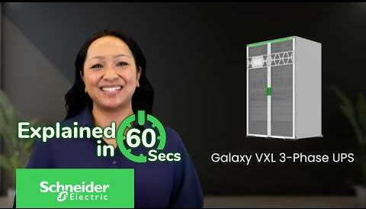
Schneider Electric YouTube Videos - Analysis
Analysis example of Altivar ATV350 Drive
GEO item checked | Score | Why this score
Video type | 2/5 | Good for brand and product discovery. Provides key product information. Less likely to answer detailed user questions or challenges.
Title | 2/5 | Clear product branding. Could be enhanced by framing it around a target search intent (e.g. „What is...” or „Key Benefits of...”).
Description | 3/5 | Could include customer problems addressed by the solution, practical use case examples, and the key questions answered by the video.
Voice-over | 5/5 | Clear spoken narration enables automatic speech-to-text (ASR) indexing by search engines.
Subtitles | 5/5 | Native closed captions ensure accurate technical terminology extraction by AI crawlers.
Link to SE web page | 5/5 | Direct link included: driving cross-domain authority between YouTube and the web.
Chapters & Timestamps | 0/5 | Missing micro-timestamps which could highlight key feature segments for LLMs (even in a short video).
Publication on SE web pages | 5/5 | Published on the official SE web page, creating strong cross-domain trust. Multi-channel footprint reinforces brand entity authority and maximizes indexation by LLM crawlers..

Slide 54

Schneider Electric YouTube Videos - Analysis
Analysis example of Galaxy VXL 3-Phase UPS Explained in 60 Seconds
GEO item checked | Score | Why this score
Video type | 4/5 | Provides key product information and some problem solving information.
Title | 4/5 | Could be in a question format.
Description | 4/5 | “What you’ll learn” section is a best practice. Could include explicitly customer‘s challenges, pain points in question format and provide data points as answers.
Voice-over | 0/5 | No spoken audio track, missing an opportunity for automatic speech-to-text indexing.
Subtitles | 0/5 | Even without a voice-over, it could be possible to add subtitles with some information (the one appearing in the video and also other information).
Link to SE web page | 5/5 | Link to SE range page is included.
Chapters & Timestamps | 0/5 | No chapters provided. Adding micro-timestamps would help LLMs index specific product features.
Publication on SE web pages | 0/5 | Not visible on SE product web pages. Not linked to the official SE source of truth. Missing opportunity to strengthen brand authority and improve search indexation.

Slide 55

Schneider Electric YouTube Videos - Analysis
Analysis example of How to Install and Pair PowerTag Resi9 with Schneider Charge Pro
GEO item checked | Score | Why this score
Video type | 5/5 | LLMs heavily prioritize step-by-step technical guides to answer user installation queries.
Title | 5/5 | High-intent 'How-to' format including exact product and brand keywords.
Description | 4/5 | Could be enhanced with explicit Q&A headers.
Voice-over | 0/5 | No spoken audio track, missing an opportunity for automatic speech-to-text indexing.
Subtitles | 4/5 | Available in multiple languages. Good strategy even without voice over - best practice! May be improved with dedicated English subtitles providing complementary technical context beyond on-screen text to maximize LLM indexing.
Link to SE web page | 5/5 | Includes direct links to both the official product range page and technical connectivity guide.
Chapters & Timestamps | 4/5 | Could be framed as search-intended questions. Essential to add a 00:00 timestamp to activate native YouTube chapters.
Publication on SE web pages | 5/5 | Published on the official SE web page, anchoring the content directly to the brand's primary source of truth.

Slide 56
GEO Optimized Videos - Checklist
The must-do essentials for making video content discoverable, retrievable, and citable by AI engines.
CONTENT & STRUCTURE
LANGUAGE & CLARITY
TRUST & CREDIBILITY
PUBLICATION
Pick AI-friendly formats: tutorials, how-to, FAQs, comparisons, case studies
Add voice-over with accurate captions (auto or .srt)
Fact-based with data, metrics, and named examples
Publish on YouTube and embed the video on SE web site. Include a link into the YT description
Structure clearly: intro > problem > solution > recap, with chapters​
Use natural, conversational, jargon-free language
Keep terminology, names, and spelling consistent throughout
Create YT metadata (title, description, chapters) both for human & LLM
Answer first - state the problem & answer within 30-90 seconds
Write explicit, self-contained sentences - no implicit references
Close with a clear summary of key takeaways
Include subtitles (independently from a voice over)
Property of Schneider Electric |
Page 56

Slide 57
AI can't watch your video - but it reads every word around it.

Slide 58
Chapter 6: GEO optimized FAQ
Jakub Falkowski
©2026 Schneider Electric. All Rights Reserved.

Slide 59
The Answer-First Framework
Question-and-answer content maps directly onto how AI assistants generate and cite responses.
AI systems read the opening lines first to decide what a page covers.
Context
Anatomy of a GEO-ready answer: Q: Can I mix Square D QO and Homeline breakers in the same panel? 1. Direct answer in first paragraph, under 25 words: A: No. QO and Homeline are separate product lines with different panel geometries. Installing the wrong line can prevent a proper mechanical and electrical connection. 2. Then supporting detail and clear next step: Always match breaker line to panel brand and model. Check the panel label or Schneider Electric's breaker compatibility guide before installing.
Structure Principles
Use the real question as the heading (H1*/H2/H3)
Answer directly in the first sentence
Keep answers to 40-80 words
Add lists for steps, specs, or options
One page per topic/product - not one mega-FAQ
Why this matters for Schneider Electric: buyers ask AI assistants highly specific product questions - breaker compatibility, UPS battery life, EcoStruxure integrations, sustainability commitments, etc. A well-built FAQ page is often the single most citable asset on a product or support page.
*H1 is always reserved for the main header of the page (usually in the banner) but on FAQ pages it is also used to expose the main question.

Slide 60
Good vs. Bad FAQ Writing
Same product question, two very different outcome.
Bad FAQ writing
Q: How often should I replace the battery in an APC by Schneider Electric UPS? A: Batteries are an important part of any UPS system, and keeping yours in good condition is key to protecting your valuable equipment. At Schneider Electric, we take battery health seriously and offer a range of solutions to keep your power protected. Battery life can vary depending on many factors, so we recommend checking your unit regularly. If you're not sure whether your battery needs replacing, our team of experts is here to help - contact us today for a personalized recommendation! Why it is bad writing: it blurs any real content under the marketing filler. It then ends in a CTA instead of an answer, so there's nothing extractable for LLM to cite.
Good FAQ writing
Q: How often should I replace the battery in an APC by Schneider Electric UPS? A: Most APC UPS batteries last 3-5 years under normal conditions. Heat, frequent outages, and age all shorten battery life - check your unit's self-test indicator or run a manual test every 6 months. Why is it good writing: Specific, self-contained, and directly quotable - exactly what an AI assistant can cite.
Important: Properly written FAQs boost GEO by pairing natural-language questions with direct, fact-specific answers that AI engines can easily extract and cite, rather than burying answers in marketing prose – making FAQs one of the top GEO impacting factors, driving visibility and traffic even without a click-through.

Slide 61
FAQ Content Writing Techniques
How to write FAQ answers that read naturally and can be extracted easily by AI engine.
Write for humans first
Natural, plain language — AI models now favor phrasing that matches how people actually speak.
Front-load the answer
Always have introductory sentence or first paragraph that summarizes the main points and hooks the reader's attention. Lead with the direct answer, then explain.
One entity term per answer
Work on one specific product/model group/range per answer, do not stack keywords as it can confuse the AI.
Use lists for structure
Steps, specs, and comparisons as bullets or numbers — easier to quote than a wall of text.
Keep it self-contained
Each answer should make sense without needing the rest of the page for context.
Avoid filler and hedging
Cut phrases like "it depends" or "in general" when a concrete answer is possible.

Slide 62
Freshness and Maintenance Cadence
Content served has to be fresh and up to date.
Policy Change
Sustainability commitments, warranty terms, and compliance answers need the fastest update path - these are high-trust, high-scrutiny answers.
3-4 months regular cycle
Review high-traffic FAQ pages on this cycle. Content refreshed this often holds citation position noticeably better than static pages.
Product update
Whenever there is any update to the product, FAQ should be reviewed and updated accordingly – independently from the regular cycle schedule.

Slide 63
FAQ as important GEO asset: Optimization Checklist
Short list to check if the FAQ page is GEO optimized.
Create a new mindset: the FAQ page is no longer a place to mop up loose ends. Written and structured well, it's one of the highest-leverage assets Schneider Electric has for being the cited, trusted source inside AI-generated answers.
Question uses real buyer language, sourced from support/sales
Answer is self-contained - makes sense out of context
Direct answer appears in the first sentence (40-80 words)
One FAQ page per product/topic, not one global mega-page
One specific product/model group/range referenced naturally, no keyword stacking
Reviewed within the last 90–120 days
Bullet points or numbered lists to be used for steps or specifications. Tables to be used for comparisons.

Slide 64
Properly written FAQs can convert AI models to be one of our best support agents – one who never sleeps.

Slide 65
Chapter 7: GEO Optimized Documents
Jakub Falkowski
©2026 Schneider Electric. All Rights Reserved.

Slide 66
How an AI turns a document into a citable answer
Six steps between publishing a file and an AI engine reading it, quoting it, or ignoring it entirely*.
1. Discovery & crawling
A crawler finds the page or file through sitemaps, internal links, or a submitted feed - nothing after this step happens if the file is never found.
2. Fetching & rendering
The engine downloads the raw file and renders any JavaScript-driven content. A scanned image or blocked file stalls here.
3. Parsing & extraction
Text, headings, and tables are pulled out using the document's tags and structure - untagged or scanned files yield little usable text.
4. Chunking
Extracted content is split into smaller passages small enough to retrieve and quote on their own, usually by heading or paragraph.
5. Embedding & indexing
Each chunk is converted into a vector representation* and stored in a searchable index alongside metadata like title and date.
6. Retrieval & citation
When a prompt matches, the most relevant chunks are retrieved and used to generate the answer - and sometimes shown as a citation.
*Vector representation (also called an embedding) is a way of turning a piece of text (a "chunk") into a list of numbers that captures its meaning.

Slide 67
Why our documents matter for GEO?
Most of Schneider Electric's technical authority lives in files, not web pages.
Context
Documents, installation manuals, whitepapers, and spec sheets carry the exact facts AI engines need: ratings, tolerances, procedures, compliance details. If those documents are locked in scanned images, inconsistent formatting, or a flawed writing style where the core message, main action, or key takeaways are completely hidden beneath overly complex language, AI can't extract or trust what's inside them. The FAQ and web-content practices only go so far - much of our deepest technical proof lives in downloadable documents instead.
Structure Principles
Lead with the answer (facts first)
Chunk into sections – one idea per heading
Arrange technical specifications, data, or features into a structured table
Deliver accessible files
Match real language - plain terms and technical names
Keep it fresh - dated, versioned or retired
Important: A document isn’t GEO optimized when it's accurate. It's finished when an AI model can quote a fact from it without misreading it.

Slide 68
Lead with the answer, not the context
The first sentence of every section should be the fact a reader (including AI) potentially came for.
State the number or spec immediately
Split multi-topic sections so each heading maps to a single, nameable question.
Save context for after
Background, benefits, and positioning belong after the fact, never before it.
One fact, one sentence
Don't fold multiple values into a single dense sentence — split them out.
Before: buried in narrative
“Our robust and reliable UPS series has been engineered by experts to deliver market-leading protection for your critical infrastructure, ensuring peace of mind for IT teams across nearly any environment.”
After: facts first
“Operating temperature: 0–40°C (32–104°F). Storage temperature: –15–45°C. Designed for server rooms and light industrial environments.”

Slide 69
Chunk content into addressable sections
Every heading should cover exactly one topic a model could quote on its own.
One topic per heading
Open each section with the concrete fact, not a scene-setting sentence.
Descriptive headers
Use headers that read like the question they answer, not generic section numbers.
Keep values isolated
Each section should make sense quoted alone, without needing the paragraph before it.
Before: one mixed section
“4.2 Maintenance — covers battery replacement, firmware updates, filter cleaning, and warranty terms all in one continuous block of text.”
After: split into topics
“Battery Replacement Interval”; “Firmware Update Procedure”; “Filter Cleaning Schedule”; “Warranty Terms” - each its own labeled section.

Slide 70
Turn spec prose into tables
Parallel attributes belong in a table, where labels and values are unambiguous.
Use tables for parallel data
Dimensions, ratings, and tolerances should be rows and columns, not sentences.
Label consistently
Use the same field names and units across every document in the library.
Keep values isolated
One value per cell - avoid combining several specs into a single cell of text.
Before: specs in prose
“The unit measures approximately 483 x 348 x 89 mm, weighs around 25.4 kg, and operates on an input voltage of 200 to 240 VAC at 50 or 60 Hz.”
After: specs in table
Dimensions (W×D×H) | Weight | Input voltage | Input frequency
483 x 348 x 89 mm | 25.4 kg | 200–240 VAC | 50/60 Hz

Slide 71
Create accessible, text-based, tagged files
AI can only cite text it can actually read out of the file
No scanned-image-only PDFs
Ensure every PDF has a genuine, selectable text layer, not just a picture of text.
Tag the reading order
Use tagged PDF structure with real headings, so heading hierarchy is extractable.
Name and describe the file
Use descriptive filenames not generic “Document1.pdf.” Please consult the Data Governance guidelines about the file’s naming. The good practice is also setting the document title/metadata*.
Before
File name: “Document1.pdf”. Scanned cover-to-cover from a printed copy - no selectable text, no heading tags, generic “Untitled” document title in file properties.
After
File name: “SmartUPS-SMX3000-Datasheet-EN.pdf.” Native text layer, tagged headings, and document title set to “Smart-UPS SMX3000 - Technical Datasheet.”
*This action can only be done in paid version of Adobe Acrobat Reader – if you create big amount of PDFs or your Team creates ultiple PDFs, you can think about requesting the full version of the tool.

Slide 72
Use the language people and models actually use
Internal naming is easy to understand for us - it’s can become invisible to everyone else.
Pair codes with plain names
Give the model number alongside the plain-language description customers search for.
Define acronyms on first use
Spell out VRLA, RBC, IP rating, etc. inline the first time each appears in a document.
Use the phrasing people ask with
Prefer “operating temperature range” over internal shorthand like “env. spec.”
Before
“SMX3000RMLV2U — refer to section 3.1 for env. spec and RBC compatibility.”
After
“Smart-UPS SMX3000RMLV2U (3000VA/2700W rack-mount UPS) — see ‘Operating Temperature Range’ and ‘Compatible Replacement Battery Cartridge (RBC)’ below.”

Slide 73
Keep documents dated, versioned, and retired on schedule
An undated document can't signal to a model whether it's still current.
Show a visible revision date
Put “last updated” or a version number on the cover page and in the footer of every document.
Maintain a changelog
List what changed between revisions, so updates to specs or procedures are traceable, and it gives signal to AI that document is beeing maintained and is up-to-date.
Retire superseded versions
Replace or clearly mark outdated documents so old specs aren't cited as current.
Before: no date, no version
Cover page reads only “Smart-UPS Datasheet” with no revision date, no version number, and an old spec value still live from three product revisions ago.
After: dated and versioned
Cover page reads “Smart-UPS SMX3000 Datasheet - Rev. 4, updated March 2026” with a changelog note: “Rev. 4: updated battery life guidance.”

Slide 74
Making document optimization routine
Cadence and ownership for the document library.
Track document-level citation status
Where possible, monitor whether AI engines cite the current document version or an outdated one still circulating online.
Review on a fixed cadence
Audit priority datasheets and manuals at least twice a year, and immediately after any product or firmware revision.
Convert the checklist into the release process
New or revised documents should pass the checklist before publishing.

Slide 75
Document optimization checklist
Run through this before publishing or updating any datasheet, manual, or whitepaper.
Does every section open with the fact, not the pitch?
Are model codes paired with plain-language descriptions?
Is each heading limited to a single, nameable topic?
Are acronyms defined on first use?
Are parallel specs presented as a table, not a paragraph?
Does the document show a visible revision date and version?
Does the PDF have a real text layer and tagged headings?
Is there a changelog for what changed since the last version?
Is the file named and titled descriptively (not “Document1”)?
Have superseded versions been retired or clearly marked?

Slide 76
If an AI can't read our expertise, it doesn't count. We need to provide the evidence, not just state the facts.

Slide 77
Chapter 8: GEO Optimized Blogs
Jakub Falkowski
©2026 Schneider Electric. All Rights Reserved.

Slide 78
Blogs – a way to show context
Blogs carry the perspective and context that technical documentation can’t.
Context
Blog posts often explain the “why” behind a trend - not just our offer. AI engines frequently pull from thought-leadership content to answer broad, exploratory prompts (“why does X matter,” “what's changing in Y”) where no single product page fits. But blogs are also where marketing voice, buried insights, and vague claims slip in most - exactly what makes content hard for a model to extract and trust. That is why, writing blogs properly is challenging yet a very important task.
Structure Principles
Don't bury the main message
Write scannable headers
Add a takeaway block
Back claims with data
Name entities clearly
Refresh evergreen blogs
Important: blogs can let us show the context and perspective that can’t always be shown. It is very important to complement those elements with blog content.

Slide 79
Lead with the answer, not the context
The first sentence of every section should be the fact a reader (including AI) potentially came for.
State the insight in paragraph one
Give the reader (human and AI alike) the main point before any scene-setting or industry framing.
Context should follow the insight
Provide the background on why the topic matters can follow the insight - never precede it.
Treat the intro as a summary
Write the opening paragraph as if it might be the only part quoted — because it often is.
Before: insight burried
“As industries around the world continue to navigate an increasingly complex energy landscape, organizations are being asked to rethink long-held assumptions about how power is generated, distributed, and consumed across their operations.”
After: insight first
“On-site microgrids can cut a facility's grid-outage exposure by running critical loads independently for hours at a time. Here's what that shift actually requires in practice.”

Slide 80
Write subheadings a model can quote out of context
Each H2/H3 should name one idea clearly enough to stand alone.
One idea per subheading
If a subhead covers two topics, split it — each heading should map to a single takeaway.
Prefer descriptive over clever
A plain, specific subhead extracts better than a pun or a vague teaser phrase.
Mirror how people ask
Phrase subheadings in the same way a reader would ask the question aloud.
Before: vague, clever headers
“The Power of Change” “A New Era Begins” “What's Next?”
After: descriptive headers
“Why Grid Congestion Is Getting Worse” “How Microgrids Reduce Outage Risk” “What It Costs to Get Started”

Slide 81
Add a compact, quotable takeaways block
Give the AI one clean passage that captures the whole argument.
3–5 bullet key takeaways
Place a short-bulleted summary near the top or bottom - not buried mid-article.
Write it standalone
Each bullet should make sense without the surrounding paragraphs for context.
Match the article's real claims
Summarize what the post actually claims - don't pad it with generic statements.
Before: no summary at all
The article's argument is spread across six paragraphs with no summary, so a reader – in that case AI model - has to reconstruct the point from scattered sentences.
After: key takeaways block
Key takeaways: Grid congestion is rising in most industrial regions On-site microgrids reduce outage exposure Payback periods now average 4–6 years

Slide 82
Back claims with specifics, not superlatives
Vague industry language gives an AI model nothing to quote or verify.
Replace adjectives with numbers
“Significant savings” isn't citable. A percentage, range, or timeframe is.
Name the source of a claim
Attribute data to its source (an internal study, a named report) rather than leaving it unsourced.
Cut hedge words that add nothing
“Many experts believe” and similar phrases dilute an otherwise citable claim.
Before: vague superlative
“Organizations that adopt smart energy management often see significant and meaningful improvements in operational efficiency over time.”
After: specific and attributable
“Facilities using automated energy management typically reduce peak demand charges by 10–15%, based on deployments across industrial sites.”

Slide 83
Name entities clearly instead of referencing them vaguely
Explicit names and links build the topical connections an AI relies on.
Name products and standards directly
Say “EcoStruxure Microgrid Advisor”, not “our software platform” - vague references can't be matched to an entity.
Link with descriptive anchor text
Use anchor text that names the destination topic, not “click here” or “learn more.”
Cross-reference related posts by name
Point to companion articles by title so the topic cluster is explicit, not implied.
Before: vague references
“Our platform helps you manage this. For more on the topic, click here. You might also like our other article on this subject.”
After: named entities and links
“EcoStruxure Microgrid Advisor helps operators model this scenario. See our guide to ‘Sizing a Commercial Microgrid’ for a full walkthrough.”

Slide 84
Keep evergreen blogs dated and current
An undated blog on a fast-moving topic can't signal that it's still accurate.
Show a visible publish and update date
Display both dates near the byline, especially for regulatory or market topics that shift.
Refresh stats and examples on a cadence
Revisit evergreen blogs at least yearly to replace outdated figures and references.
Redirect or retire outdated blogs
If a blog is superseded by newer guidance, merge, redirect, or clearly flag it as outdated.
Before: undated, stale
No visible date on the post. Cited market figures are from an outdated period, and the post still references a discontinued product line as current.
After: dated and refreshed
“Published: March 2025 - Updated: June 2026.” Figures and product references refreshed to reflect current offerings and market data.

Slide 85
Making document optimization routine
Cadence and ownership for the document library.
Schedule an annual evergreen refresh
Revisit high-traffic evergreen posts at least once a year to update stats, examples, and product references.
Keep searching for topics
Review and monitor the topics your audience is actively talking about. Be ready to provide information before anybody else does.
Track citation status alongside traffic
Monitor whether AI engines cite your posts on core topic prompts, not just organic clicks and rankings.

Slide 86
Blog optimization checklist
Check the boxes before publishing or refreshing any blog post.
Does the opening paragraph state the core insight?
Are claims backed by numbers, not superlatives?
Is scene-setting positioned after the main point?
Is data attributed to a named source?
Does every subheading cover exactly one idea?
Are products and standards named explicitly?
Are subheadings descriptive rather than clever?
Do links use descriptive, topic-named anchor text?
Is there a 3–5 bullet key-takeaways block?
Does the post show a visible update date?

Slide 87
Good thought leadership still needs a quotable source. Say the important message first – then tell the story around it.

Slide 88
Chapter 9: Prompt into Content – Content Reverse Engineering
Jakub Falkowski
©2026 Schneider Electric. All Rights Reserved.

Slide 89
Proactive vs Reactive GEO
From fixing broken answers to architecting the AI knowledge base.
Before we start this chapter:
For GEO and AI visibility, it is very important to be the first – provide the source of narrative before anybody else. This chapter is what to do when someone else took that spot from us and now we need to put an effort to claim it. It is very likely we would not need to do this if we would be proactive – securing the top spot first.
Reactive - today
Focus: Analyse how AI answers now and try to 'fix' inaccuracies. Action: reverse-engineer existing prompts and cited pages. Limitation: always playing catch-up - fighting for space in narratives competitors already own.
Proactive – tomorrow’s aproach
Focus: shape the narrative before the AI solidifies its understanding. Action: create 'citation-ready' content pillars from grounded signals and anticipated conversation chains. Advantage: become the foundational source - forcing competitors to react to our narrative.
Important: True GEO leadership means moving from fixing broken answers to proactively architecting the AI's knowledge base.
Property of Schneider Electric |
Page 89

Slide 90
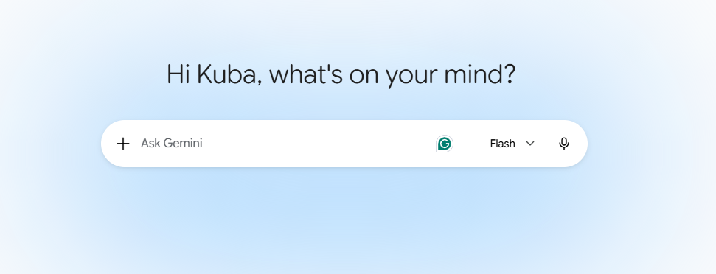
Prompt optimization – goal and inspiration
What if we run out of optimization ideas or simply think that all that could be done is done? Sometimes the best place to look for GEO optimization ideas is what AI considers good content worth to mention and cite.
Context
If, despite ongoing efforts, your content is not being recognized by AI, the most effective next step may be to examine what content is being cited by AI and reverse-engineer the underlying approach for your own pages. This does not mean copying or closely rewriting that content. Rather, the cited material should be analyzed for its context, keyword usage, tone of voice, and overall messaging. This analysis can then serve as a benchmark to inform and inspire the content strategy for your own page. Very important is to also understan the 2 frameworks: YMYL and E-E-A-T as sometimes they can be absolute #1 AI visibility factor.
Property of Schneider Electric |
Page 90

Slide 91
What are YMYL and E-E-A-T?
There are 2 frameworks that we need to know before we try to understand why our content is not performing.
E-E-A-T Framework:
Experience
First-hand, real-world experience with the topic — having used the product, visited the place, or lived the situation.
Expertise
Depth of knowledge or skill in the subject, shown through credentials, training, or clear command of the material.
Authoritativeness
Recognition as a go-to source by others in the field — citations, reputation, and inbound references.
Trustworthiness
Accuracy, transparency, and honesty — the most heavily weighted factor, especially for YMYL topics.
YMYL
“Your Money or Your Life”
Finance and investing
Health and medical
Legal, civic and safety
Major life decisions
Content that can affect a reader’s health, finances, safety, or wellbeing — held to the highest quality bar by search and generative engines alike.
Property of Schneider Electric |
Page 91

Slide 92
Why are YMYL and E-E-A-T so important?
And how knowing them can help us beeing mentioned and cited.
Higher stakes, stricter filter
E-E-A-T is the trust proxy
An AI answer carries the platform’s authority, not just a link — so YMYL sources get vetted harder before they’re used.
AI can’t verify truth directly, so it leans on experience, expertise, authority, and trust to judge who’s citable.
Fewer citations, harder cut
Trust is hardest to fake
Search shows 10 links; AI answers cite 3–5. Weak E-E-A-T means exclusion — not just a lower rank.
Real credentials, transparent authorship, and consistent accuracy are what actually earn the citation.
Important: no E-E-A-T, no citation — especially on YMYL topics.
Property of Schneider Electric |
Page 92

Slide 93






The How: a 5-step prompt audit
Run this on every prompt where Schneider Electric is absent from the AI answer - each step below unpacks the specific questions to ask and what to log.
Context
Keywords
Tone of voice
Messaging
Sources cited
Intent behind the prompt
Terms the answer uses
How it's said
What it claims and how it's proven
Who's winning instead
Property of Schneider Electric |
Page 93

Slide 94



Step 1: Context
Read the prompt the way the model does.
What is the real intent?
Informational, comparison, troubleshooting, or purchase-decision - the answer format the model chose is a clue to how it classified the question.
Log this:
Record the verbatim prompt, the inferred intent, and every entity the AI surfaces - including competitors and unrelated brands. This becomes your baseline for every later step.
What entities does the AI attach to it?
Which products, standards, industries, or competitor names appear alongside the topic, even if unprompted?
How broad or narrow is the scope?
A category-level question and a specific technical detail question call for very different page types and depth.
Where should our content already fit?
Map the prompt to the closest existing page - the gap is often in fit, not in topic coverage.
Property of Schneider Electric |
Page 94

Slide 95

Step 2: Keyword Usage
Compare their vocabulary to ours.
Exact phrasing match
Does the cited content mirror the user's own words, or does it rely on internal product naming and jargon?
Technical / brand-specific terms
Log this:
Build a two-column term list: “terms the cited answer uses” vs. “terms our page uses.” Every mismatch is a candidate edit.
Note precise terms the AI repeats (model families, standards, part numbers) - these anchor citation-worthy answers.
Synonyms and related terms
Check how deep the content ventures into the topic, to support main message.
Jargon check
Flag any brand-only terminology in our content that a general audience - or the model - wouldn't recognize.
Property of Schneider Electric |
Page 95

Slide 96


Step 3: Tone of Voice
Decode how the winning content speaks.
Formality level
Technical and precise, or conversational and plain-language? Match the register the model is already rewarding.
Perspective
Log this:
Rate the cited answer on formality, perspective, and confidence - then rate our current page the same way, side by side.
Neutral third-party explainer, instructional how-to, or first-person vendor voice - each reads differently to an answer engine.
Confidence and specificity
Direct numbers and steps outperform hedged marketing language (“it depends,” “contact us”).
Voice check
Does the cited content sound like a trusted expert, or like a brand talking about itself? Ours should read as the former.
Property of Schneider Electric |
Page 96

Slide 97

Step 4: Messaging
Unpack what the answer actually proves.
Anchoring facts
What specific numbers, ranges, or mechanisms does the answer lead with? These are usually the exact sentence quoted.
Structure used
Log this:
Extract the single sentence most likely to be quoted verbatim from the winning content. Then check: does our page have an equivalent message?
Direct answer first, then a scannable list or steps — versus a buried answer inside narrative paragraphs.
Proof points
Named studies, product-specific behavior, or diagnostic detail that a generic competitor couldn't easily replicate.
Self-containment
Does the answer resolve the question fully in place, or does it require a click-through to be useful?
Property of Schneider Electric |
Page 97

Slide 98

Step 5: Sources cited
Study who is winning the citation - and why.
Who is cited?
Direct competitors, independent reviewers, forums, distributors, or industry publications - each implies a different fix.
What format do they use?
Log this:
Keep a running “cited-instead-of-us” source list per topic cluster – check the results every month. Recurring domains become priority benchmarks.
Editorial page, FAQ page, how-to guide, structured spec sheet, or blog - note the format the model favored.
What authority signals do they show?
Named authorship, cited studies, visible expertise, freshness — signals we can match or exceed.
Is it a one-off or a pattern?
Check 3–5 related prompts. A source that recurs across variants is worth a deeper competitive teardown.
Property of Schneider Electric |
Page 98

Slide 99
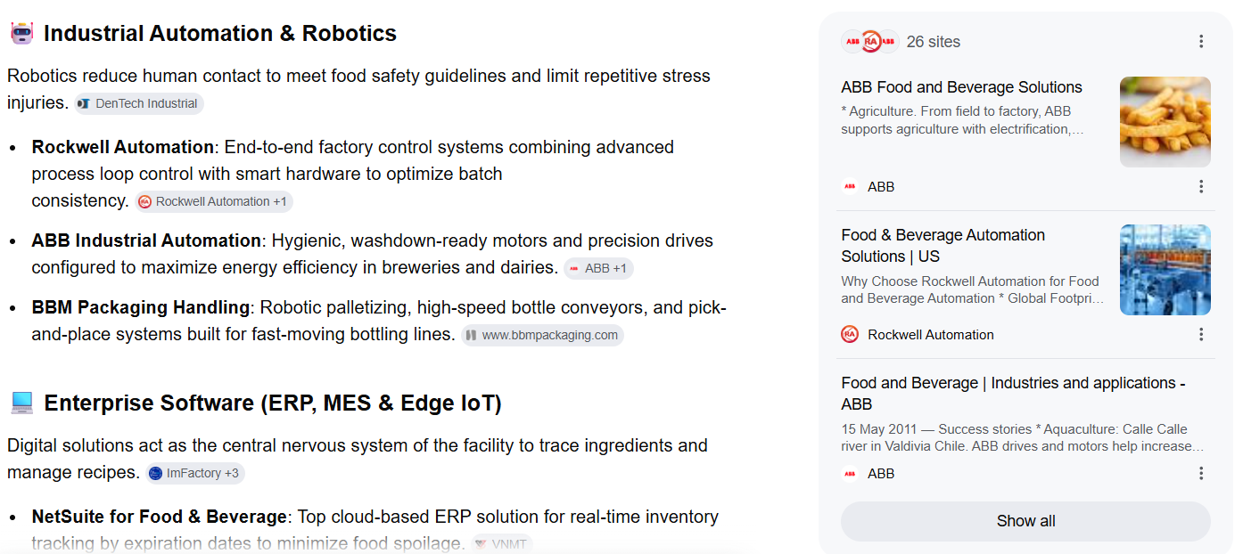
Prompt Analysis Example
AI answer
The prompt: what are the best industrial solutions for food and beverage business?*
Main message
Mentions – content needs to be analyzed
Sources cited – content needs to be analyzed
Main messages from cited sources
*Source: Google Gemini
Property of Schneider Electric |
Page 99

Slide 100
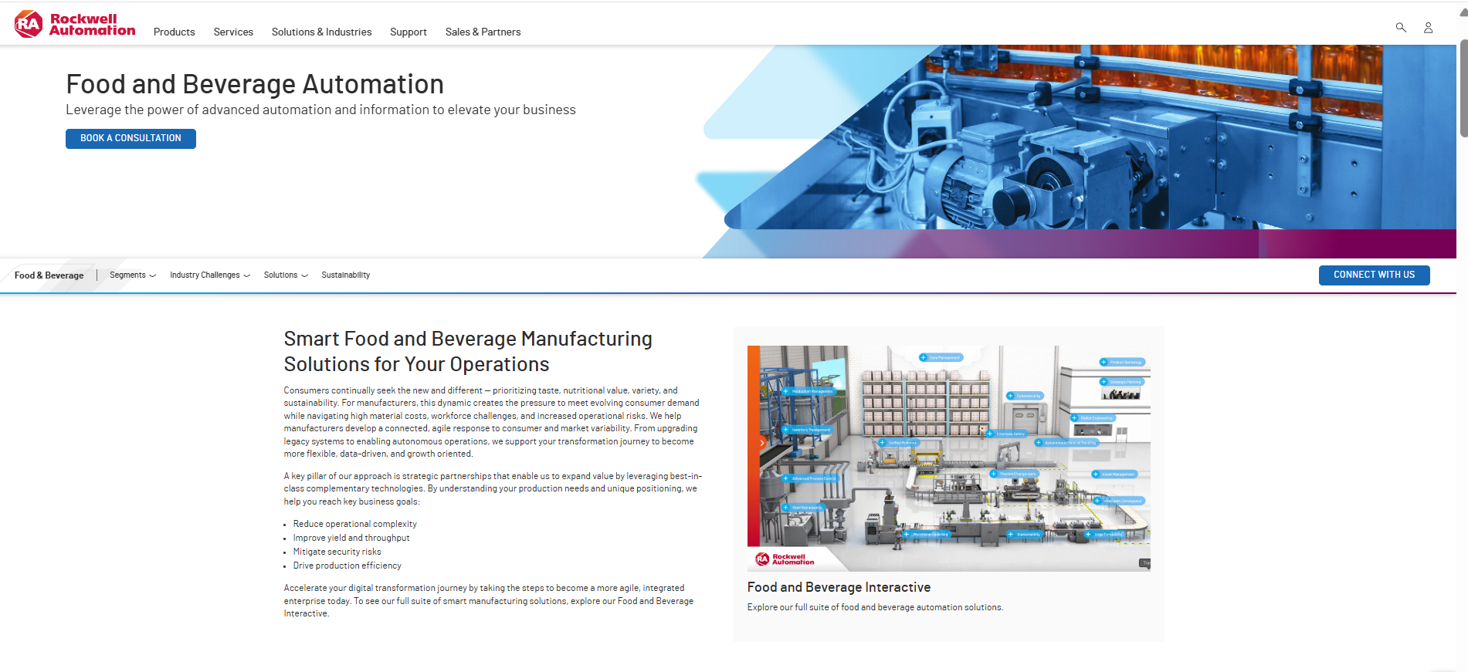
Prompt Analysis Example
Cited page example
The prompt: what are the best industrial solutions for food and beverage business?*
Infographic for content presentation modality – positive signal sent to AI.
CTA and links
Context, main messages and potential answer to the prompt should be on the top of the page
Examine the rest of the page following the 5 step analysis.
*Source: Google Gemini
Tone of voice and vocabulary used
Property of Schneider Electric |
Page 100

Slide 101
From analysis to action: the reverse-engineering worksheet - example
Dimensions | Observed in cited content | Gap on our page | Optimization action
Context | Prompt framed as troubleshooting | Page framed as a product pitch | Reframe intro as a direct diagnostic answer
Keywords | Uses precise technical term | Page uses internal product name only | Add the user-facing term alongside ours
Tone of Voice | Neutral, expert, instructional | Marketing-forward, hedged | Rewrite in direct advisory voice
Messaging | Leads with a specific number | Answer buried in paragraph 3 | Move the number to the first sentence
Sources | Independent review site cited | No comparable independent-style content | Publish an unbiased comparison page
Property of Schneider Electric |
Page 101

Slide 102
Making this a habit, not a one time action
Own and grow your content.
Run quarterly, per topic cluster
Re-test priority prompts every quarter, and immediately after a major page rewrite, to confirm the gap actually closed.
If you do not own the content – cooperate with the owner
Identify and connect with key stakeholders for the content that impacts your business
Keep a shared findings log
Centralize prompt, intent, cited sources, and the resulting action for every audit — avoid re-discovering the same gap twice.
Track citation status as a metric
Treat “cited vs. not cited” per priority prompt as a reportable KPI alongside traditional organic visibility.

Slide 103
We don't need to guess why we're missing. We need to study what’s already winning - then out-answer it.

Slide 104
Chapter 10: GEO Optimization and Social Media/Online Communities
Jakub Falkowski
©2026 Schneider Electric. All Rights Reserved.

Slide 105
Why is it important?
Social Media and online communities are having the same impact on our share of citation as our own website.
Context
YouTube videos, LinkedIn posts, review sites, Reddit threads, and forums make up the 26%* of what determines whether an AI engine cites Schneider Electric. This means social and community presence isn't a nice-to-have add-on to GEO - it is big piece of the game. Winning here requires marketing, comms, PR, and product/field experts working shoulder to shoulder.
Important: for Schneider Electric as B2B company, big amount of citations come from our Partners and Distributors websites.
*Data source: Profound, July 2026

Slide 106
LinkedIn
The anchor channel.
Executive voice over brand voice.
Executive voice is our strongest asset. They have many followers, are active with others in the B2B space and are often cited in AI models.
Actions:
Named executives and technical leaders post original perspective - not reshares - on decarbonization, grid modernization, and industrial AI, each written to be quotable and other must-win topics.
Launch/expand employee advocacy: employee-shared content earns significantly more engagement compared to the same post from a brand page. AI models trust individuals more than corporate accounts.
Employee advocacy startegy: LinkedIn users should not start right away with creating the content – instead ask them to start with 2-3 weeks comments only activity before posting the new content by themselves. It produces stronger long-term participation than launching straight into content creation.
Align positioning language across se.com, SE Blogs, etc. — LLMs cross-reference these to build the brand's entity model.
Publish original data (energy trend analysis, decarbonization benchmarks, etc.) as native LinkedIn documents — earned reshares are exactly the third-party validation GEO rewards.

Slide 107
YouTube
The fastest-growing lever.
Actions:
Format*: technical explainers, executive Q&As, customer walkthroughs, product comparisons - not brand films. These are the formats AI engines actually cite.
Length: 10–20 minutes, with the direct answer front-loaded in the first 30% of the transcript - the 'AI citation zone.'
Never rely on auto-captions alone - upload corrected transcripts with accurate product names (e.g. EcoStruxure, Galaxy, Micro Data Center) and technical terms.
Add timestamped chapters phrased as questions; a single chaptered video can earn multiple separate citations.
Write 300+ word descriptions as structured summaries - description length has a measurable positive correlation with citation frequency.
Embed on-site with a full transcript and VideoObject schema** - most engines cannot 'watch' a video, only read the text around it.
Structure beats
view count.
YouTube's view count has "close to zero" correlation with AI citation. Long-form, well-transcribed, chaptered video is what gets cited - a natural fit for SE's technical depth.
*For detail video creation strategy please visit Chapter 5 of this Toolkit.
**For schema markup explanation please visit Chapter 14 of this Toolkit.

Slide 108
Reddit and Technical Forums
The anchor channel.
Authenticity
is the key.
Let people speak.
Actions:
Never post as an anonymous brand account link-dropping to se.com - this is the fastest way to lose all credibility and does not get cited.
Use real, named participation: a transparent brand-linked account signed by an employee, or genuine participation disclosing affiliation.
Answer questions, don't advertise - panel sizing, PLC troubleshooting, EV charging, sustainability reporting, data center cooling.
Seed original research valuable enough that a community member reshares it unprompted - the legitimate path to citation-worthy presence.
Assign a small, senior, technically credible team - never an intern or a bot.
Expect 6+ months to build durable authority; manufactured/ coordinated posting is identified quickly and typically triggers backlash within weeks.

Slide 109
A 90-day Starting Roadmap
Example of an easy start.
Days 1–15 | Days 16–45 | Days 46–75 | Days 76–90
Baseline and governance Do the citation gap check*. Organize cross-functional working group. Audit LinkedIn/se.com positioning consistency. | Foundation and LinkedIn Restructure 10–15 flagship pages (answer-first, fact-dense, FAQ schema). Launch the employee advocacy pilot. Fix GEO gaps on 5 to 10 existing videos, relevant for the content you want to win. | Community expansion Identify 3–5 subreddits/forums per vertical with named, disclosed participants. Publish monthly original research. Launch the always-on review program. | Measure and expand Re-run the citation gap check against baseline. Report citation share. Prioritize next quarter by business priority.
*For detail audit strategies please visit Chapter 13 of this Toolkit.

Slide 110
Five Things to Remember
Key takeaways.
1
Community and social signals drive roughly 25% of AI citation - this is cross-functional earned media, not a content calendar.
2
LinkedIn, YouTube, Reddit/forums third – those are key examples, but Schneider Electric should be present in every community that can bring impact.
3
Write everything answer-first, fact-dense, and attributable to a named source.
4
Employee voice outperforms brand voice on every channel that matters.
5
Measure by engine and by category - and expect a 2-week to 6-month timeline depending on the channel.

Slide 111
Chapter 11: Linking Structure to Enhance GEO – Internal and External
Jakub Falkowski
©2026 Schneider Electric. All Rights Reserved.

Slide 112
Link Building Evolution: From Link Equity to AI trust
SEO link building chased ranking position. GEO link building earns a citation inside an AI-generated answer.
The change:
Internal linking = the foundation. It makes Schneider Electric's own content coherent, consistent, and machine-legible. It mostly controls whether AI systems can understand and trust what we say about ourselves — necessary, but not the differentiator.
External mentions (NOT links) = the dominant lever for citation. Third-party corroboration is what AI engines weigh most heavily when deciding whether to cite a brand at all. the message an external source uses to describe the brand matters more than whether it includes a clickable link.
 | SEO Link Building | GEO Link and Mention Building
Goal | Climb ranking position for target keywords | Be named/cited inside an AI-generated answer
Unit of value | The hyperlink (link equity/ domain rating) | The brand-named passage on a trusted domain
Reward | A blue-link click from a search results page | A direct citation or recommendation, often with no click
Internal links | Distribute “link juice” to priority pages | Prove entity consistency across a topical knowledge graph
External links | Do follow backlinks from any authoritative domain | Third-party corroboration - a link is a bonus, not a requirement
Important: A third party mention, matters more to an AI model than a link. It does not mean we do not need external links. Links still work for SEO and can direct users to our page. High quality content should work shoulder to shoulder with external linking.

Slide 113
Internal linking: machine-legible knowledge graph
Internal link are no longer about “link juice.” It is to let AI retrieval systems confirm one claim against another across the site.
Technical
spec sheet
Example of consolidated linking structure:
Hub Page
Customer
case study
Link by entity, not keyword
Same product/program always links to one canonical page
Anchor text reads like a real answer, not “click here”
Every hub page opens with a 40-60 word extractable definition
No orphaned pages – every page should be connected to the structure
Product page
Regulatory page
Related
glossary term

Slide 114
Where to earn third-party corroboration
Ranked roughly by the trust weight AI engines tend to place on the source.
Sources of mentions and backlinks
Analyst reports – data is evaluated highly by AI
Standards and government bodies – providing official information and statements
Trade and vertical press – relevant industry information with high credibility
Wikipedia and Wikidata - neutral, independently-sourced, and repeatedly returned to by AI systems
Review and comparison platforms - vertical review sites feed AI “best of” answers
Customer and partner case studies – published on customer/partner’s own website
Podcasts and transcribed video - a quoted spokesperson is a citable, brand-named passage
Examples of tactics to produce external links that impacts AI most:
Original research & data
Commission proprietary statistics, Data is the most “borrowable” asset for journalists and analysts.
Coordinated amplification
Land the same story or quote across several trusted outlets in a short window. Multi-source corroboration is what AI engines look for.
Rapid-response commentary
A standing list of spokespeople by topic, able to answer journalist queries within hours.
Refresh outreach
Revisit older coverage with updated statistics or a sharper current-market angle to prevent citation decay.
Executive bylines
Contributed articles in trade and business press on topics with impact on the business priority.
Track unlinked mentions
Monitor brand mentions without a hyperlink too - these still count for AI visibility.

Slide 115
Plan Internal and External Together
And what to avoid.
Hub pages receive the win | External validates internal claims | One shared entity map
Every digital-PR placement points back to - or is cross-referenced from - the relevant internal hub page. | Sustainability and performance claims are stronger in AI answers once independently corroborated (e.g. analyst reports, customer case studies). | Knowledge graph of your scope so you can keep track on what pages are connected – and how.
Dont’s
Paid link schemes and low-quality guest posts - marginal help for traditional SEO; little to no AI trust signal, with reputational risk. | Disguised advertorials - content that reads as brand-controlled is increasingly discounted by AI systems, even hosted externally. | Inconsistent entity naming - different names or claims across press releases, bylines, and product pages undermine cross-source corroboration.

Slide 116
90-day Starter Checklist
For every marketer.
Confirm priority topic hub pages exist and are linked in a product/proof/policy triangle.
Verify all major AI models are permitted for your public content.
Identify 3–5 target analyst reports, trade publications, or standards bodies and begin outreach.
Audit the last 6 months of press releases and case studies for orphaned pages and inconsistent naming.
Nominate a rapid-response spokesperson for expert/journalist/community queries in your topic area.
Identify one proprietary statistic or piece of original research to offer press/analysts this quarter.
Check that Wikidata/Wikipedia facts for your business unit or product line are current and sourced.

Slide 117
Chapter 12: Editorial and Product UX design
Jakub Falkowski
©2026 Schneider Electric. All Rights Reserved.

Slide 118
Good UX Is Now Part of GEO
The “why” UX Optimization Matters for GEO.
Context
When we are talking about UX, we are thinking about providing our users the best experience, trying to anticipate their needs but also reach our goal. Now AI models are becoming users too. This is big mindset change to start thinking about machine as a regular user that has its own needs.
Current Rules | New Mindset
Designing for the click | Designing for the answer
Human-only audience | Dual audience — humans and AI agents
Funnel thinking: multi-step journeys | Moment thinking: every page a self-sufficient entry point
Visual hierarchy alone | Visual hierarchy paired with semantic structure
Engagement as a vanity metric | Engagement as a trust signal AI systems weigh
One monolithic page | Modular, independently citable content blocks
Structure Principles
Information Architecture
Scannability and chuncking
Cognitive load reduction
Key takeaway: The future of search is not just about ranking content. It is about designing experiences that become trusted sources for AI-generated answers.

Slide 119
Information Architecture
Structure content so generative engines can parse hierarchy instantly.
Optimized Information architecture:
Mirror the query in your hierarchy
H1-H3 headers should echo how people phrase the question, not internal jargon.
One idea per section
Each heading owns a single, extractable concept - no overlapping subtopics.
Avoiding structure complexity
Cap depth at 3 levels so the structure stays easy to traverse and cite.
Use real semantic tags
H1-H3 and lists, not bold paragraph text pretending to be a heading.
Query-matched Hierarchy
Prompt: What is GEO and how can I improve it?
Information architecture:
<H1> What is GEO
<H2> Why it matters
<H3> Ranking Signals
<H2>How to Optimize
<H3> Content structure
<H3> UX principles
UX action: design your information architecture around topics and user intent, not around your organization. This helps both users and AI find, understand and trust your content.

Slide 120
Scanability and Chunking
Use UX to break content into small, self-contained units an engine can extract on their own.
Chunking checklist:
  Paragraphs capped at 3–4 sentences
  Numbered steps for any process or sequence
  Bulleted lists for attributes and features. Tables for comparisons.
  <strong> key terms so meaning survives a skim
  Tables for anything with more than 2 data dimensions
BEFORE
AFTER
Dense paragraphs with no visual hierarchy — hard to extract a clean answer from.
Short, labeled chunks map directly onto extractable answer units.

Slide 121
Cognitive Load Reduction
Minimize the understanding effort required to extract meaning from the page.
Cognitive load is the amount of mental effort needed to process information — the less clutter and complexity in the way, the more of that effort goes toward actual understanding rather than struggling with presentation.
Plain language first
Define jargon on first use — engines and readers both need a clean glossary.
One idea per section
Avoid stacking multiple claims or CTAs in a single block of text.
Consistent terminology
Pick one term per concept and reuse it - synonyms fragment topical signal.
Show, don’t narrate
A diagram, table, or chart replaces a paragraph of dense description.
How easy it is for AI model to understand the content by enhancing content structure:
Unstructured page
Adding clear hierarchy
Having chunked content
Using plain language
Each principle compounds - hierarchy, chunking, and plain language together cut extraction effort the most.

Slide 122
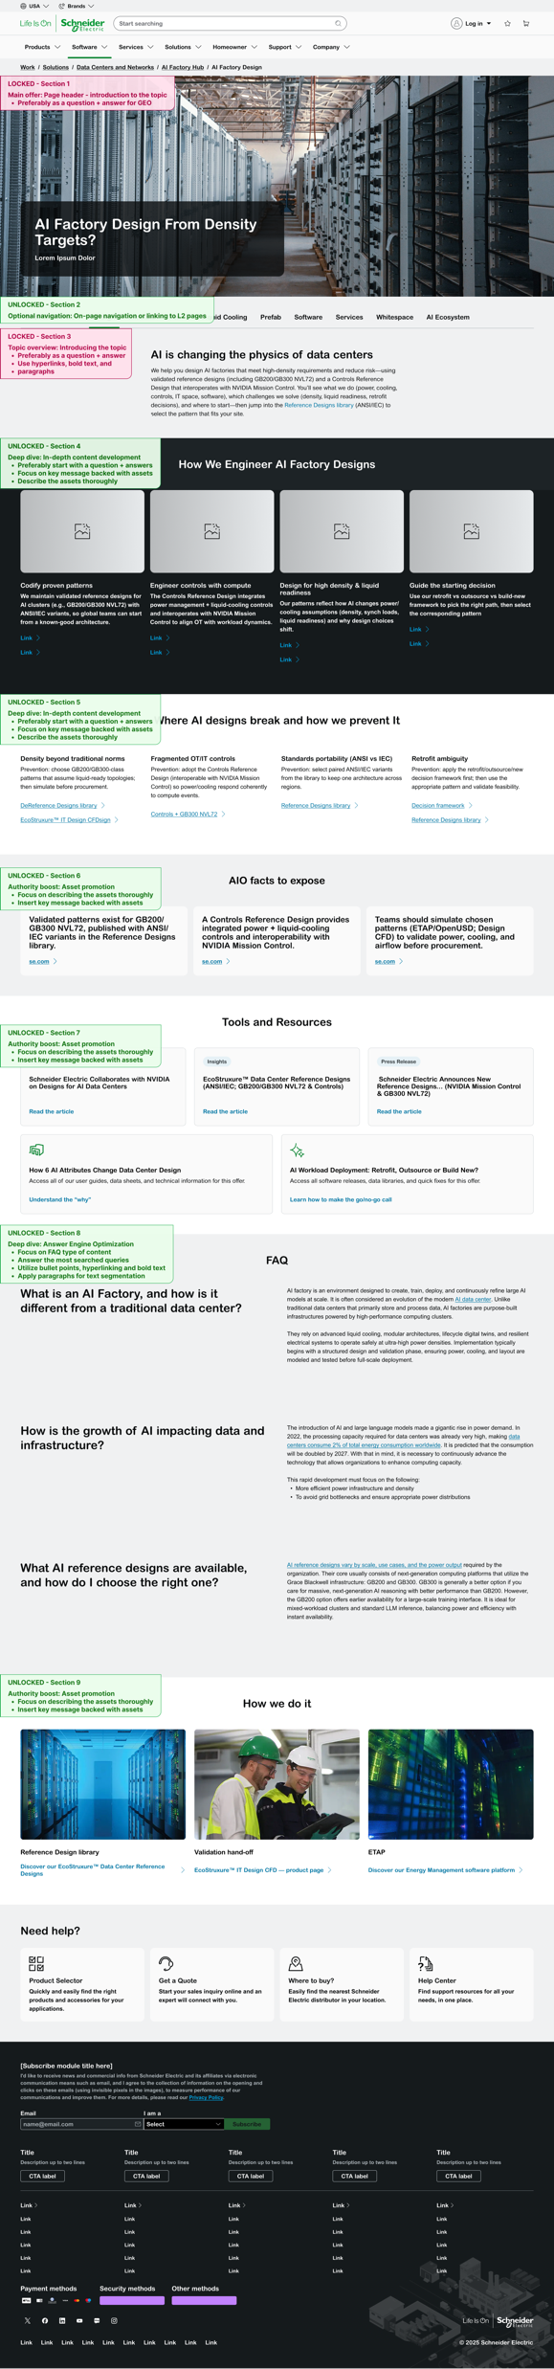
Schneider Electric Templates
Links to SE UX template optimized for GEO.
Content and UX Team are creating multiple optimized UX templates for different goals and types of pages. There are 3 options for GEO optimized template usage to achieve different goals:
GEO Power Page Template – a standalone page focused on enhanced AI visibility.
GEO Optimized Template – a page that focuses on a different goal (e.g. conversion), while keeping key GEO elements.
GEO Power Couple – a fully GEO optimized page, targeting both an AI model (digestibility) and the human reader (conversion) as targeted users. This strategy uses GEO Power Page Template.
Above pages are editorial page templates optimized for GEO. We can optimize content for GEO on other pages like Product Destails Page, Product Range Page, Product Category Page, Supercharge Experience Page, CaaS Page, and more. Please remember, some content can’t be edited in Builder.IO because it comes from a database like PIM or OfferDAM. In these instances, consult your PIM Champion.
Important: pages can have different goals, so don’t always assume you can cover all principles in one page. It can be trickly to get optimised results for multiple principles.
Example: if you want to build a page for AI visibility and include conversion elements, it could harm your main goal (AI visibility). Focus or the main goal to avoid risking a page that doesn’t perform well in any of the intended areas.
Property of Schneider Electric |
Page 122

Slide 123
Chapter 13: GEO Analytics
Jakub Falkowski
©2026 Schneider Electric. All Rights Reserved.

Slide 124
About this Chapter
GEO Analytics with your laptop.
Context and goal
There are multiple tools that can help you tracking your prompts, providing share of voice and share of citation score. Schneider Electric of courses uses this type of tools, currently we are using Profound for prompts tracking and AI visibility support. But as a owner of a particular web page or an asset, you do not need to have access to the advance tools – your laptop and access to the World Wide Web (BTW this is what is behind famous WWW) is all that you need to check and follow your GEO position. If you have access to the free tool provided by Google like Google Analytics 4 or Google Search Console you will be able to track your performance and build improvement plan based on data.

Slide 125
Content Gap Mapping: Authority Voids
Audit existing assets against the strategic GEO pillars.
P1
Visibility — the foundation
Content built to be found and cited for core, high-volume topics.
Why audit?
The challenge: we must systematically find where Schneider is 'blind' in AI-engine results.
The solution: a structured Content Gap Map that scores coverage against three strategic pillars — the roadmap for prioritized content creation.
Are we present?
P2
Channel — the platform
Content tuned to each AI platform's flow (ChatGPT vs Perplexity).
Are we formatted correctly?
P3
Sentiment — the perception
Content that shapes perception and corrects AI inaccuracies.
Important: Visualizing gaps across Visibility, Channel and Sentiment gives a clear roadmap for prioritized content creation.
Are we viewed favorably?
● Covered ◐ Partial ● Gap

Slide 126
Prompt Testing with Multiple AI Models
No special tool needed – just fixed set of prompts and making testing a habit.
Build a fixed prompt panel
Run across major engines
Score every answer
Track share of voice
20–50 prompts covering products, categories, use cases or anything related to your page/content/asset.
Ask each prompt in ChatGPT, Perplexity, Gemini, Copilot, and Google Gemini on a fixed monthly date.
Mentioned? Cited? Sentiment (positive
/neutral/negative)? Position (led with, or buried after competitors)?
Log results in a simple sheet: your mentions vs. named competitors, per prompt, per engine, over time.

Slide 127
Prompt Testing with Multiple AI Models
No special tool needed – just fixed set of prompts and making testing a habit.
Example of comparison tables to easy track our presence in AI. We can compare the results with any competitor in multiple AI models. Metric used:
Mentioned: A metric confirming whether your brand name or product is included or completely omitted within an AI engine's response.
Cited: A metric indicating if the AI engine explicitly linked to your website as a clickable source for the information it provided.
Position: The numerical rank or visual placement of your brand or link within the AI-generated answer, such as being the first recommended product.
Sentiment: The overall emotional tone (positive, neutral, or negative) and favorability that the AI engine uses when describing your brand to the user.
Schneider Electric – Chat GPT
Prompt | Mentioned | Cited | Position | Sentiment
Prompt 1 | yes | Yes | First | Positive
Prompt 2 | Yes | No | N/A | Negative
Prompt 3 | No | No | N/A | N/A
Prompt 4 | Yes | Yes | Fifth | Neutral
Siemens – Chat GPT
Prompt | Mentioned | Cited | Position | Sentiment
Prompt 1 | No | No | N/A | N/A
Prompt 2 | No | No | N/A | N/A
Prompt 3 | Yes | Yes | Third | Neutral
Prompt 4 | Yes | Yes | First | Positive

Slide 128
How to Use the Harvested Data
Converting information into action plan.
Track: Log the cited URL, not just the mention
Analyze: Reverse-engineer what wins*
Act: Feed the content roadmap
For every AI answer that cites Schneider Electric, record the exact page. Patterns emerge fast across enough prompts.
Check cited pages for clear H1/H2 structure, FAQs, recent update dates, and direct, quotable answers. Where a competitor is cited instead, open their page and diagnose the gap: better structure, fresher data, or a question you simply hasn't answered.
Convert every recurring gap into a content brief: a new FAQ, an updated spec page, or a clearer comparison page.
*For detail explanation of content reverse engineer mechanism and actions please visit Chapter 9 of this Toolkit.

Slide 129
GEO Strategic Score – Web Page Assessment
A formula to calculate our own GEO performance.
To calculate the Strategic GEO Score, you must evaluate your content across its technical, semantic, and AI-interpretability layers using a weighted average formula.
The Core Formula:
The final score is a weighted average of your site's performance across critical AI visibility indicators, normalized to a 100-point scale:
Raw GEO Score= SUM of all (Component Score x Component Weight)
Final Strategic GEO Score= (Raw GEO Score/5)x100
Standard Framework Weights: each component is graded on a 0 to 5 rubric based on how effectively an AI crawler parses and elevates the content
Metric | Weight | Definition
AI Interpretability | 30% | Evaluate technical formatting that allows Large Language Models (LLMs) to scan your data. This includes clean HTML structure, optimized server-side rendering, and explicit bot allowance in your LLMs.txt and robots.txt files.
Semantic Richness | 25% | Grade the density of your entities, natural synonyms, and the depth of factual data available for the LLM to pull into its context window.
Conversational Relevance | 20% | Assess how directly the content matches long-tail conversational user prompts and follows Q&A formats.
Structural Optimization | 15% | Review your schema implementation. High scores require explicit schema markup for Organization, FAQPage, Article, or HowTo to allow structured snippet retrieval.
Generative Engagement Rate | 10% | A lagging indicator measuring how often the live AI engine actually pulls from this URL when prompted.
GEO tips & tricks
You don’t need to evaluate the score by yourself – use AI to do it for you, simply by asking it to give you the score per metric.

Slide 130
GEO Strategic Score – Web Page Assessment
Example of calculation and results.
Step-by-Step Calculation Example
If a target page scores the following on your internal 0–5 point grading rubric:
AI Interpretability: 4/5
Semantic Richness: 5/5
Conversational Relevance: 3/5
Structural Optimization: 5/5
Generative Engagement: 2/5
Weighted Raw Score: 1.20* + 1.25 + 0.60 + 0.75 + 0.20 = 4.0
Normalized Final Score: (4.0/5) x 100 = 80 out of 100.
*We calculate the weighted score: the score was 4/5, the weight is 30% so 0.3 – 4x0.3=1.2
Score | Result
< 40 (Poor) | High priority for immediate remediation.
40 - 69 (Average) | Needs improvement. Add to the optimization backlog.
70 - 89 (Good) | Well-optimized. Minor tweaks may be needed.
90+ (Excellent) | Best-in-class. Use as an internal example.

Slide 131
Tech GEO Health KPIs
Technical paramaters are mesured to monitor AI visibility of se.com.
Technical GEO is as importnat as content – we can’t be mentioned or cited if we are not visible to AI. Schneider Electric Digital monitor key KPIs for se.com and other SE domains to ensure that the key elements are present on the pages. Below are the KPIs elements and weights.
Weight | % of Health URL1 | % of Health URL2 | Element
1 or 0 | 1 | 1 | Robots.txt
1 or 0 | 0 | 1 | noindex
1 or 0 | 1 | 0 | Canonical
1 or 0 | 1 | 1 | Status code
4 | 0 | 0 | <p> of relevant content
4 | 50 | 0 | <h1> and <h2>
4 | 100 | 0 | <title>
Weight | % of Health URL1 | % of Health URL2 | Element
4 | 100 | 0 | Hyperlinks
4 | 100 | 0 | Structured Data
3 | 100 | 0 | Breadcrumbs
2 | 100 | 0 | HTML lang
2 | 100 | 100 | SE Sitemapas <Manual
1 | 100 | 0 | Meta description

Slide 132
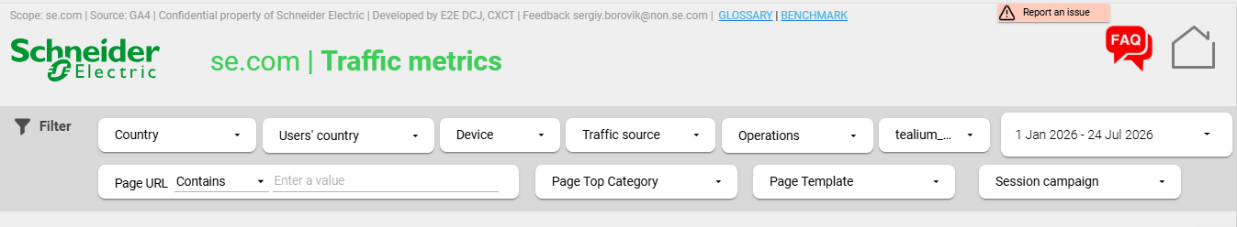
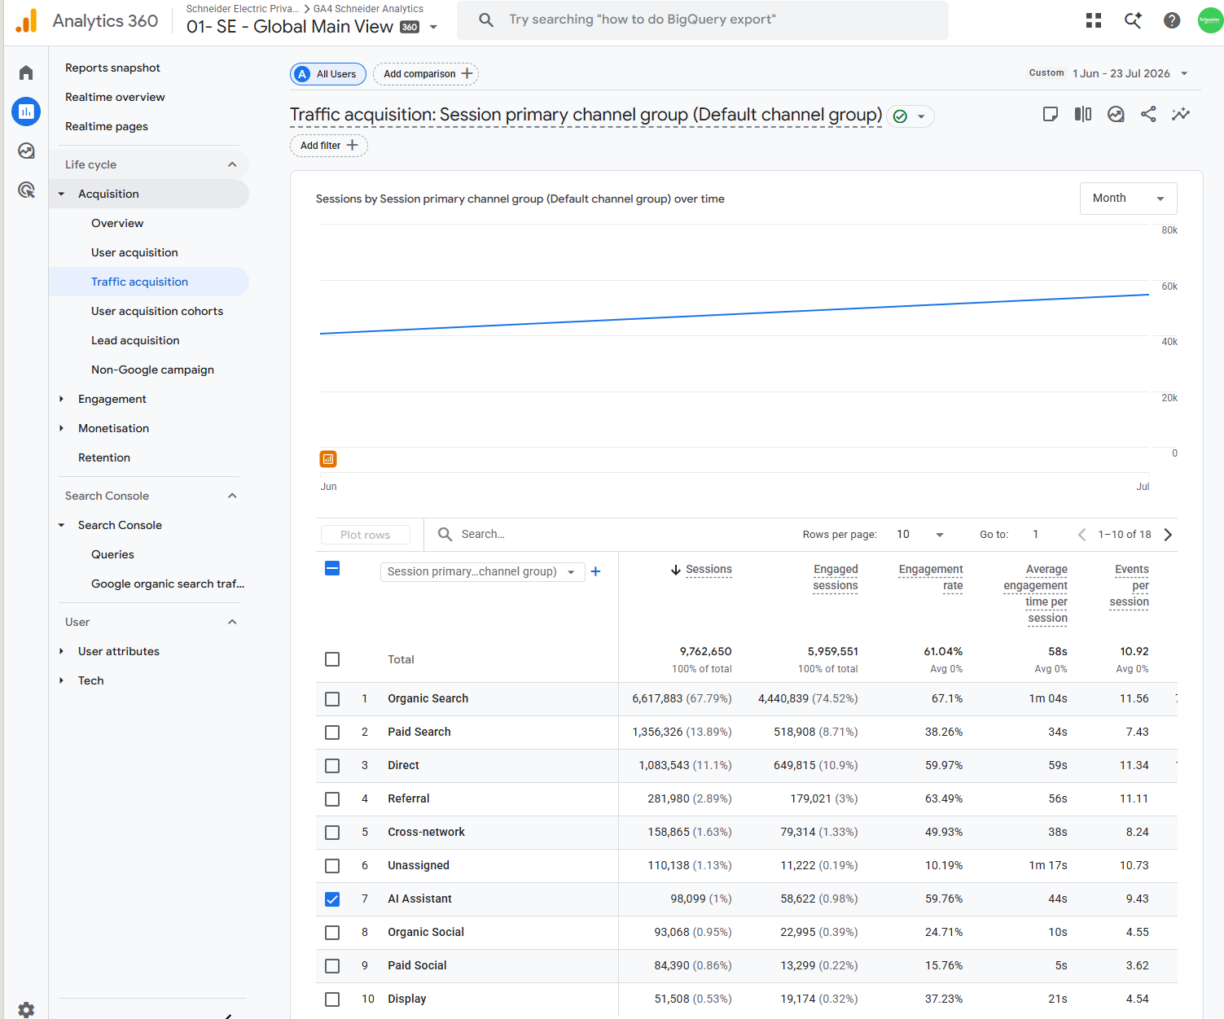
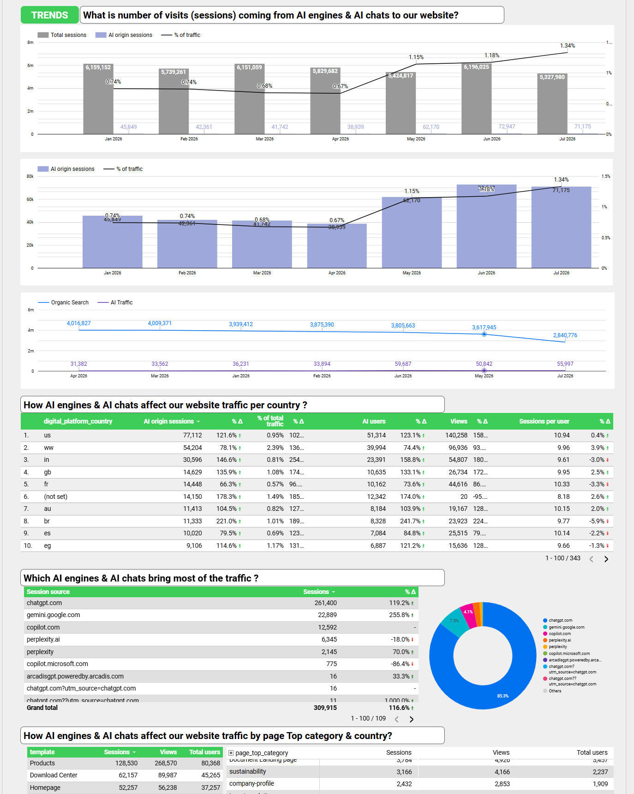
Available Tools that Everybody can Use
Google Analytics 4
Google Analytics
In GA tool under Report>Aquisition>Traffic Aquisition section you can easily track the AI Assistant* traffic evolution.
This view will provide you visibility on the number of clicks (sessions started on se.com) coming from citations together with engagement metrics. The same kind of report can be reached for mySchneider, shop & eshop properties.
Digital Platforms’ Performance Dashboard (Looker Studio report)
Built by the Web Analytics & Performance Team using GA data, this dashboard provides advanced traffic insights, including a dedicated AI Traffic section.
Navigate to Traffic > Deep Dive within a platform to analyze AI traffic, citation sources, AI traffic share trends, and breakdowns by country, and page category. Available for se.com, mySchneider, shop.se.com, and eshop.se.com.
Access requirements: To view Google Analytics and the DPP Looker dashboard, ensure that you have been granted access to the relevant GA4 property for your platform of interest. Full process here.
Coming soon: Google Search Console AI Overview
Google is rolling out AI Overview tracking in GSC – it will be a great opportunity to track our visibility in AI-powered Google searches. We will keep you posted when Schneder Electric gets functionality.
* AI Assistant group was introduced by Google in Jun’26 therefore you can only analyse data from mid-Jun 2026 using this group.
For the past, you can take a look on dimension „Session Default Channel Group 2” and „AI Traffic” group created as custom field by Digital Analytics team.

Slide 133
Chapter 14: Technical GEO
Jakub Falkowski
©2026 Schneider Electric. All Rights Reserved.

Slide 134
About this Chapter
Technical GEO Knowledge base
Context
This chapter was created as a knowledge base about Technical GEO - not a practical playbook like the rest of the chapters. It exists to document what Technical GEO is and how it works but all the Technical GEO activities are delivered by Schneider Electric Digital. Highlights: Schneider Electric Digital is working continuously to improve visibility of its digital properties among AI models and AI-driven search experiences. Technical GEO is a fast-evolving area - standards, crawler behavior, and AI-search infrastructure change frequently, so this chapter focuses on durable concepts rather than one-time instructions. Practical, actionable guidance - the steps teams can take - is addressed separately in the other chapters of the GEO Playbook. It is also recommended, that you check in the code of the page/content you own, all the below informations are included. You can easily do it by inspecting the page’s code and searching for specific items.

Slide 135
Making our Content Machine-Readable
So the content optimization can even matter.
Context
Even the best-written page can't be cited if an AI crawler is blocked, can't render the content, or can't parse the facts on it. Technical GEO is the infrastructure layer underneath everything else in this playbook. Technical GEO refers to the infrastructure- and code-level factors that determine whether AI systems — large language models, AI-powered search, and answer engines — can discover, access, parse, and trust a website's content.
Technical GEO Principles
Crawler Access Control
Structured Data & Schema Markup
Rendering & Crawlability
Entity & Knowledge Graph Alignment
Other Contributing Technical Signals
How it relates to traditional Technical SEO?
Technical GEO builds on many of the same foundations as technical SEO (crawlability, structured data, site architecture), while introducing considerations specific to how AI systems fetch, chunk, and cite content differently from traditional search crawlers.

Slide 136
How AI Systems Access Web Content
And how websites communicate crawl and usage preferences to AI systems.
Three broad categories of automated access
Training Crawlers Collect content to train foundation models. Access happens periodically and is unrelated to any specific user query. | Retrieval / Search-Index Crawlers Build the index that AI answer engines cite from in real time. These are the crawlers most directly tied to appearing in AI-generated answers. | User-Triggered Fetchers Activate at the moment a person asks an AI assistant about a specific page or URL, fetching that page live in response to the request.
Access control signal: robots.txt – old ways | Access control signal: llms.txt – new horizon
A long-standing web protocol that lets a site declare, per user-agent, which paths a bot may or may not access. Compliance is voluntary - an “honor system.” Major AI labs generally state that their crawlers respect it. Some bots have inconsistent compliance records and are known to disregard disallow rules in practice. Distinguishes rules by exact user-agent, allowing different treatment for training vs. retrieval vs. user-triggered bots. | An emerging, community-proposed standard (first put forward in September 2024) — a Markdown file at a site's root offering a curated index of its key pages for AI systems to read. Not yet a formal standard; adoption as of 2026 is described as niche but growing, concentrated among technical and documentation-heavy sites. A related llms-full.txt variant offers a complete text export of a site's content, rather than just an index. Purpose is to reduce the navigation, scripts, and ad markup an AI system would otherwise have to process to find the substance of a page.
Where are we: currently SE is relying on robots.txt but one of 2027 Technical GEO initiatives is a development of llms.txt.

Slide 137
Structured Data: Schema Markups
Maps and road signs so AI can understand where it is and what it reads.
Schema Markup
Schema markup is a specialized code added to a website's backend that helps search engines understand content context, enabling rich search results like star ratings, prices, and business hours (explicit, machine-readable meaning to page elements). It uses a shared vocabulary from Schema.org to label data so machines can easily read it.
How does schema markup look in the code? Example of Product schema markup:
<script type="application/ld+json">
{
"@context": "https://schema.org",
"@type": "Product",
"name": "EcoStruxure IT",
"category": "Data Center Infrastructure
Management (DCIM)",
"brand": {
"@type": "Organization",
"name": "Schneider Electric"
},
"description": "Cloud-based DCIM software
for monitoring UPS, power, and cooling
across distributed sites."
}
</script>
Commonly referenced schema types
Organization Identifies a business entity — name, logo, official profiles, and relationships to other entities. | Product Describes product attributes, offers, and availability in a standard, comparable format. | FAQPage Marks up question-and-answer pairs as discrete, individually addressable units.
Article Identifies editorial content, authorship, and publication/update dates. | HowTo Describes a sequence of steps toward a defined outcome. | BreadcrumbList Describes a page's position within a site's hierarchy.

Slide 138
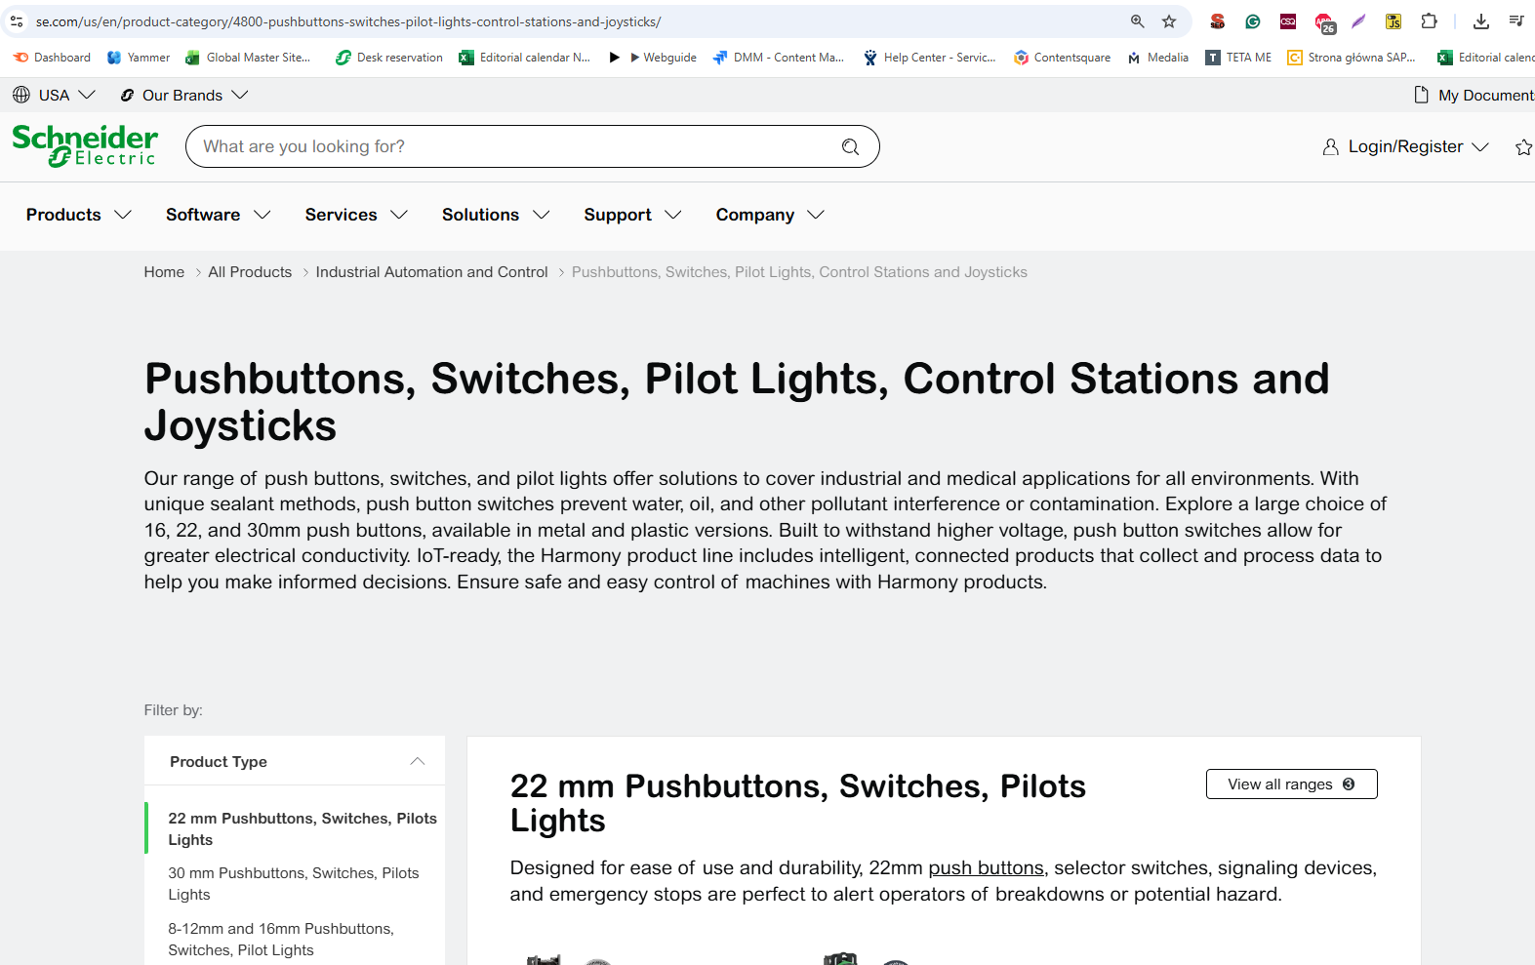
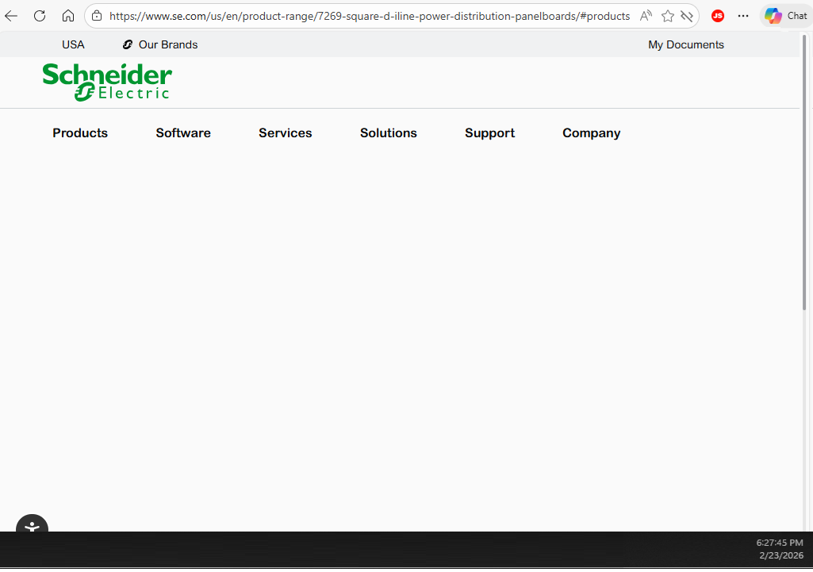
Rendering and Crawlability
Server-Side Rendering or Client-Side Rendering?
Server-Side Rendering (SSR)
The server delivers a page's full HTML content immediately, before any script executes.
Client-Side Rendering (CSR)
Content is assembled in the browser via JavaScript after the initial page load, rather than being present in the raw HTML.
Human - User View - CSR
Machine – AI Bots (e.g. ChatGPT can’t read JavaScript)
Why does it matter for AI and which one is recommended?
Many AI crawlers process raw HTML and do not execute JavaScript. Content that is only rendered client-side may, as a result, be effectively invisible to those crawlers even though it is visible to a human visitor.
In Schneider Electric there is ongoing project to move all out pages to SSR to enhance the visibility level. Project is planned to be fully delivered by Februray 2027.

Slide 139
Entity and Knowledge Graph Alignment
Sowing AI the structure of the website and everything that relates to it.
An entity is a distinct real-world thing — an organization, a product, a person — that AI systems build an internal representation of, drawing on multiple sources across the web rather than any single page.
Mechanism for entity identification
Naming consistency Using the same name, spelling, and description for an entity across a site and its external profiles, reducing ambiguity when systems attempt to match records. | Knowledge base presence Association with established reference sources such as Wikidata or Wikipedia, which many AI systems draw on when resolving what an entity is. | sameAs links A structured-data property connecting a page to authoritative external profiles of the same entity — for instance, official social profiles or a Wikidata record.
Consistent entity identification helps AI systems correctly disambiguate a brand and connect information about it that is spread across many sources. For international company like Schneider Electric having with multiple web channels, it is very important to present ourselves as one entity, building up our domain authority and AI credability.

Slide 140
Other Contributing Technical Signals
Additional factors commonly referenced in Technical GEO discussions – good to know.
Semantic HTML
The use of HTML markup that clearly describes the meaning and purpose of its content to both the browser and the developer, using elements like <article>, <nav>, and <header> instead of generic tags.
XML Sitemaps
A machine-readable index listing a site's URLs, used by crawlers as a starting point for discovering content.
Canonicalization
A signal indicating which URL is the authoritative version among near-duplicate or similar pages.
Freshness Signals
Timestamps, such as a <lastmod> date, that indicate when content was last created or updated.
Page Performance
Loading speed and stability, which can affect how much of a site a crawler completes within its allotted time or resources
hreflang
A signal indicating that equivalent content exists in other languages or for other regions.
Schneider Electric Digital is working on all ofinitiatives, enhancing our performance with every realease. Many of the above (and other activities, not listed here) are not only impacting GEO, but multiple initiatives on se.com – they are beeing developed by multiple teams in the same time.

Slide 141
Glossary and Main Contacts
Jakub Falkowski
©2026 Schneider Electric. All Rights Reserved.

Slide 142
GEO Glossary
GEO and AI related terms that you can find in this tolkit or while working with GEO.
AEO (Answer Engine Optimization): The practice of optimizing content to be the single, definitive answer returned by voice assistants and AI engines.
AI chatbot: A conversational software application powered by artificial intelligence that interacts with users and answers queries in natural language.
AI crawler: An automated bot deployed by AI companies to scan, scrape, and gather data from websites to train machine learning models.
AI hallucination: A phenomenon where an AI model generates confident responses that contain false, inaccurate, or fabricated information.
AI Model: Any mathematical algorithm trained on data to recognize patterns, make predictions, or generate content.
Cite Rate: The frequency or statistical likelihood of an AI engine linking back to your specific domain as a verified source.
CMS (Content Management System): A software application or platform used to create, manage, modify, and publish digital content on websites.
Context Window: The maximum amount of text or data an LLM can process and remember at one single time during a prompt interaction.
CTA (Call to Action): A prompt, button, or phrase designed to encourage website visitors to take a specific, immediate action.
GEO (Generative Engine Optimization): The process of optimizing digital content so it is accurately cited and recommended by generative AI search engines.
H1/H2/...: HTML heading tags used to structure content hierarchically, helping both human readers and AI crawlers understand page topics.
Indexing the page: The process by which search engines or AI bots discover, analyze, and store web pages in their database for future retrieval.

Slide 143
GEO Glossary
GEO and AI related terms that you can find in this tolkit or while working with GEO.
Listicle: A short-form article or piece of content written in a structured, easy-to-read list format.
LLM (Large Language Model): A deep learning algorithm trained on massive datasets to understand, summarize, generate, and predict textual content.
Prompt: The natural language input, question, or instruction given to an AI system to guide its generated output.
ROI (Return on Investment): A financial metric used to evaluate the efficiency or profitability of an optimization campaign relative to its cost.
Schema markup: A standardized code format added to a website to help AI and search engines understand the explicit context of its data.
Sentiment Alignment: The practice of formatting content to match the positive, neutral, or analytical tone that AI models naturally favor for recommendations.
SEO (Search Engine Optimization): The foundational practice of increasing website visibility and organic traffic from traditional search engines.
UX (User Experience): The overall experience, ease of use, and satisfaction a visitor has when interacting with a website or application.
Zero-Click Search: A search engine results page interaction where the user's query is fully answered directly on the page, requiring no external clicks.

Slide 144
CXCT:
Jakub Falkowski – Global GEO Lead
Brand & Communications:
Salman Kureishi – Traffic Insights Manager
Matt Graves – Global SEO Manager
SE Digital:
Antoine Bisch – Principal, Web Performance
Giuseppe Forciniti – Web Perforance/Technical SEO Specialist
Main GEO contacts

